Slide 1
The Azure SQL Workshop

Slide 2

The Azure SQL Workshop
Module 1 Introduction to Azure SQL
Module 2 Deploy and configure
Module 3 Security
Module 4
Performance
Module 5
Availability
Module 6
Putting it all together
aka.ms/azuresqlfundamentals
aka.ms/sqlworkshops
Notes:
9-10: Logistics/Module 1/2
10-10:45: Module 2 Activities
10:45-11: Break
11-11:30: Security
11:30-12:30: Security activities
12:30-1:30: Lunch
1:30-2: Perf
2-2:45: Perf activities
2:45-3: Break
3-3:30: Avail
3:30-4:15: Avail activities
4:15-5: Putting it all together

Slide 3
Introduction to Azure SQL
Module 1
SQL
Overview
SQL Server on Azure VMs
Azure SQL Managed Instance
Azure SQL Database
Comparison and summary

Slide 4

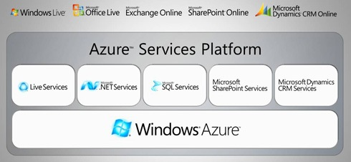
History of Azure SQL
Overview
SQL Server on Azure VMs
Azure SQL MI
Azure SQL Database
Comparison and summary

Slide 5
Azure SQL has come a long way
2006
CloudDB
RedDog
2008
Windows Azure and SQL Data Services announced
2010
Windows Azure and SQL Azure launch
2012
SQL Azure →
Azure SQL Database
2013
Azure
Virtual Machines
2014
Windows Azure → Microsoft Azure
2015
Azure SQL Database V12
2016
Azure SQL Database Elastic Pools
2018
Azure SQL Database Managed Instance
2019
Azure SQL Database Hyperscale
Azure SQL Database Serverless
Azure SQL Instance Pools
Overview
SQL Server on Azure VMs
Azure SQL MI
Azure SQL Database
Comparison and summary
Notes:
2006
CloudDB Project
RedDog Project
2008
Windows Azure and SQL Data Services announced at PDC
2010
Windows Azure and SQL Azure officially launch.
2012
SQL Azure branded Azure SQL Database
2013
Azure Virtual Machines released
2014
Windows Azure branded Microsoft Azure
2015
Azure SQL Database V12 released
2016
Azure SQL Database Elastic Pools released
2018
Azure SQL Database Managed Instance released
2019
Azure SQL Database Hyperscale Released
Azure SQL Database Serverless Released

Slide 6
Azure Ecosystem
Azure Accounts and Subscriptions
Azure Portal
Azure Marketplace
Azure APIs and CLIs
Azure Resource Manager (ARM)
Azure Monitor
Azure Regions and Datacenters
Azure SLA, Compliance, and Trust
Overview
SQL Server on Azure VMs
Azure SQL MI
Azure SQL Database
Comparison and summary

Slide 7



Azure SQL
A unified SQL portfolio built on the industry-leading SQL Server engine
SQL Server on Azure Virtual Machines
Azure SQL Managed Instance
Azure SQL Database
Best for re-hosting and apps requiring OS-level access and control
Automated manageability features and OS-level access
Best for modernizing existing apps
Offers high compatibility with SQL Server and native VNET support
Best for building new apps in the cloud
Pre-provisioned or serverless compute and Hyperscale storage to meet demanding workload requirements
Infrastructure as a Service
Platform as a Service
Overview
SQL Server on Azure VMs
Azure SQL MI
Azure SQL Database
Comparison and summary

Slide 8

SQL Server on Azure VMs provides the promise of the cloud while maintaining OS control
Key features
SQL Server and OS server access
Expansive SQL and OS versions
Windows, Linux, Containers
File stream, DTC, and Simple Recovery model
SSAS, SSRS, and SSIS
Azure differentiators
Free Extended Security Updates for SQL Server 2008/R2
Automated Backups and Security Updates
Point in Time Restore with Azure Backup
Accelerated storage performance with Azure Blob Caching
435 percent overall return on an Azure IaaS investment over five years¹
Customer challenge
I want to migrate to the cloud as fast as possible but maintain operating system control and complete SQL Server functionality
Solution
Get the combined performance, security, and analytics of SQL Server, backed by the flexibility, security, and hybrid connectivity of Azure
Healthcare software manufacturer saves costs when reusing licenses while moving 600 on-premises VMs to Azure
1. Forrester Consulting. The Total Economic Impact™ of Microsoft Azure SQL Database Managed Instance.
Overview
SQL Server on Azure VMs
Azure SQL MI
Azure SQL Database
Comparison and summary
Notes:
Best for migrations and applications requiring OS-level access
Challenges
The contract on my hardware is expiring
I have instances of SQL Server 2008 and 2008 R2
I want to migrate to the cloud as fast as possible
I use third party software that needs OS-level access
I have dependencies on SSRS
I want to extend our on-premises apps to Azure
I need an unlimited number of DBs
I want the full feature set of SQL Server 20XX
Solution
SQL Server and OS server access
Expansive SQL and OS version support
File stream, DTC, and Simple Recovery model available
Automated patching and backup
Free Extended Security Updates for SQL Server 2008/R2*
435 percent overall return on an Azure IaaS investment over five years (Forrester Consulting)
Up to 3.4x faster and 87% cheaper than AWS EC2**
Azure Key Vault integration
Support for Linux and Windows
Note: maybe only 1 here – the best one, rest in notes
Does your application require custom VM or SQL config? DB engine version choice, feature compatibility with SQL box, app portability, access to VM/OS
* ESU worth 75% of license every year for the next three years after EOS; ** Applicable to Azure Marketplace images, customers using customer SQL Server 2008/R2 custom images can download the ESU for free and manually apply.
VMs: Allscripts https://customers.microsoft.com/en-us/story/allscripts-partner-professional-services-azure
Move 600 VMs to Azure within a few weeks. Some time later moving some to MI
Rehost SQL Server 2008 and 2008 R2 in Azure Virtual Machines to get three years of Extended Security Updates at no additional charge and upgrade to a newer version when ready
435 percent overall return on an Azure IaaS investment over five years (for a composite organization based on the interviewed customers) (Forrester Consulting)
https://azure.microsoft.com/en-us/overview/azure-vs-aws/cost-savings/#sql-server-iaas

Slide 9
SQL Server on Azure Virtual Machines
Marketplace pre-installed SQL Server on Windows or Linux
Install your own SQL Server
Lift and Shift with Azure Migrate (Azure Site Recovery)
Deployment Choices
Unlock Licensing and Edition Flexibility
Automated Backups and Security Updates
Manage VMs through Azure SQL in portal
Resource Provider
Memory or Storage optimized sizes for best performance
Data and log on Premium Storage Managed Disks
Azure Blob Read Caching for data disks
Tempdb on local SSD
Ultra disks for extremely low latency needs
Sizes and Storage Performance
Networking and Security
Virtual Networks to integrate with on-premises
Advanced Data Security services (Preview)
Azure VM built-in HA
Azure Storage built-in DR
Azure Backup and Automated backups to Azure Blob Storage
File-Snapshot Backups
Failover Cluster Instance with Azure Premium File Share
Always On Availability Groups with Cloud Witness
Hybrid Availability Group Secondary replicas
HADR on RedHat Linux with Pacemaker and fencing
HADR
Overview
SQL Server on Azure VMs
Azure SQL MI
Azure SQL Database
Comparison and summary

Slide 10
IaaS vs PaaS
Business continuity
Scale
High availability
Advanced security
Automated backups
Version-less
Long term backup retention
Built-in monitoring
Geo-replication
Built-in intelligence
Overview
SQL Server on Azure VMs
Azure SQL MI
Azure SQL Database
Comparison and summary
Notes:
Business continuity enables your business to continue operating in the face of disruption, particularly to its computing infrastructure.
High availability of Azure SQL Database guarantees your databases are up and running 99.99% of the time, no need to worry about maintenance/downtimes.
2 read replicas - GP
3 replicas, 1 read-scale replica, zone-redundant HA - BC
Primary read/write replica + up to 4 read replicas - HS
Automated backups are created and use Azure read-access geo-redundant storage (RA-GRS) to provide geo-redundancy.
Also Point in Time restore
Long term backup retention enables you to store specific full databases for up to 10 years.
Geo-replication by creating readable replicas of your database in the same or different data center (region). You can manually failover to readable replicas
Also Auto-failover groups allows an application to recover in case of a data center outage
Scale by easily adding more resources (CPU, memory, storage) without long provisioning.
Advanced security detects threats and vulnerabilities in your databases and enables you to secure your data.
Automatic tuning analyzes your workload and provides you the recommendations that can optimize performance of your applications by adding indexes, removing unused indexes, and automatically fixing the query plan issues.
Built-in monitoring capabilities enable you to get the insights into performance of your databases and workload, and troubleshoot the performance issues.
Built-in intelligence automatically identifies the potential issues in your workload and provides you the recommendations that can help you to fix the problems.
Versionless
Azure SQL Database and Managed Instance are versionless
Our “main branch” powers SQL Server, Azure SQL Database, and Managed Instance.
Microsoft consistently updates SQL Server instances
@@VERSION does not align with SQL Server versions
Fixes and feature updates not controlled by users
But…worry-free patching for both underlying OS and SQL Server
Updates are rolled out in “trains”.
New features can be whitelisted to specific customers (aka Private Preview)
Public Preview is typically available to all but limited support and discount pricing (if applicable)
All fixes in SQL Server eventually show up in Azure but timing may be different from CU
Not all fixes in Azure make it into a CU for SQL Server (but typically next major release)
Some fixes are specific to Azure
Follow these links to see new features, major fixes, and feature updates

Slide 11

Azure SQL managed instance eases cloud migration
Key features
Single instance or instance pool
SQL Server surface area (vast majority)
Native virtual network support
Fully managed service
On-premise identities enabled with Azure AD and AD Connect
Azure differentiators
Near zero downtime migration using log shipping
Fully managed business continuity with failover groups
Projected return on investment of 212 percent over three years¹
The best of SQL Server with the benefits of a managed service
Customer challenge
I want to migrate to the cloud, remove management overhead, but I need instance-scoped features (Service Broker, SQL Server Agent, CLR…)
Solution
Managed instance combines leading security features with SQL Server compatibility and business model designed for on-premises customers
Komatsu easily migrated 1.5 TBs of data thanks to near complete compatibility with SQL Server, plus 49% cost reduction and 25-30% performance gains.
1. Forrester Consulting. The Total Economic Impact™ of Microsoft Azure SQL Database Managed Instance.
Overview
SQL Server on Azure VMs
Azure SQL MI
Azure SQL Database
Comparison and summary
Notes:
Best for most lift-and-shift migrations to the cloud
It is called an Instance because it is equivalent to a Database Engine Instance of SQL Server which we define actually in our docs at https://docs.microsoft.com/en-us/sql/database-engine/configure-windows/database-engine-instances-sql-server?view=sql-server-ver15. The term Database Engine Instance is important because other instance types for SQL Server are things like SSAS.
It's called Managed because it is a PaaS version of a Database Engine Instance where we manage several things including install of SQL Server, scaling, and high-availability.
Challenges
I want to migrate to Azure
I want to remove some of the management overhead and stress with regards to business continuity, high availability, and disaster recovery
I need instance-scoped features like SQL Server Agent, Database Mail, Service Broker, CLR, etc.
Solution
Single instance or Instance pool
SQL Server surface area (vast majority)
Native virtual network support
Fully managed Service
Enable your on-premise identities on cloud instances, through integration with Azure Active Directory and AD Connect
Near zero downtime migration using log-shipping
Fully managed business continuity with failover groups
Projected return on investment of 212 percent over three years (Forrester Consulting)
Combine the best of SQL Server with the benefits of a managed service
You get two levels of isolation:
Cluster level: Managed Instances for a tenant are fully isolated from other tenants. No connectivity or resource sharing is possible between different tenants.
Networking level: joining instances to a subnet in a VNET and restricting access to private IP addresses only provides full isolation from public Internet.
Managed Instance: Komatsu https://customers.microsoft.com/en-us/story/komatsu-australia-manufacturing-azure
Moved about 1.5 TBs of data very smoothly because of the near 100% compatibility with SQL Server
49% reduction in cost and 25% increase in performance gains

Slide 12

Azure SQL Database is built for modern cloud apps
Key features
Single database or elastic pool
Hyperscale storage (100TB+)
Serverless compute
Fully managed service
Private link support
High availability with AZ isolation
Azure differentiators
Industry highest availability SLA of 99.995%
Industry only business continuity SLA with 5 second RPO and 30 second RTO
Price-performance leader for mission-critical workloads while costing up to 86 percent less than AWS RDS (GigaOm)
Customer challenge
I want to build modern apps, potentially multi-tenanted, with the highest uptime and predictable performance
Solution
Azure SQL Database is a highly scalable cloud database service with built-in high availability and machine learning
AccuWeather uses Azure SQL Database to provide an automated, scalable weather prediction service
1. Forrester Consulting. The Total Economic Impact™ of Microsoft Azure SQL Database Managed Instance.
Overview
SQL Server on Azure VMs
Azure SQL MI
Azure SQL Database
Comparison and summary
Notes:
Best for modern cloud applications
Challenges
I want to build a modern multi-tenant SaaS app
I want to use a database with dedicated resources and predictable performance
I want to independently scale compute and storage in my database
I want to have unlimited databases storage when I need it
I want to build a mission critical application with highest uptime
I want to integrate Azure services into my applications
Solution
Single database or elastic pool
Hyperscale storage (100TB+)
Serverless compute
Fully managed service
Private link
High availability with AZ isolation
Business continuity at scale
Intelligent database
Industry highest availability SLA of 99.995%
Industry only business continuity SLA with 5 second RPO and 30 second RTO
Price-performance leader for mission-critical workloads while costing up to 86 percent less than AWS RDS (GigaOm)
Database: AccuWeather https://customers.microsoft.com/en-us/story/accuweather-partner-professional-services-azure
New intelligent applications. Using Azure Machine Learning Services to make sales and customers predictions

Slide 13
Azure SQL MI or DB?
Azure SQL managed instance
Azure SQL Database
Single instance
SQL Server surface area (vast majority)
Native virtual network support
Fully managed service
Instance pool
Pre-provision compute resources for migration
Enables cost-efficient migration.
Ability to host smaller instances (2Vcore)
Currently in public preview
Single database
Hyperscale storage (up to 100TB)
Serverless compute
Fully managed service
Elastic pool
Resource sharing between multiple databases to price optimize
Simplified performance management for multiple databases
Fully managed service
Overview
SQL Server on Azure VMs
Azure SQL MI
Azure SQL Database
Comparison and summary

Slide 14
Service tiers – Managed Instance
General purpose
Business critical
Most business workloads
Workloads that require low latency, fast recovery, and a readable secondary
vCore model
Independent scalability
Remote storage
Local storage
IOPS
$
IOPS++
$$$
In-memory
P
P
S
S
R
Overview
SQL Server on Azure VMs
Azure SQL MI
Azure SQL Database
Comparison and summary

Slide 15
Azure SQL MI or DB?
Azure SQL managed instance
Azure SQL Database
Single instance
SQL Server surface area (vast majority)
Native virtual network support
Fully managed service
Instance pool
Pre-provision compute resources for migration
Enables cost-efficient migration.
Ability to host smaller instances (2Vcore)
Currently in public preview
Single database
Hyperscale storage (up to 100TB)
Serverless compute
Fully managed service
Elastic pool
Resource sharing between multiple databases to price optimize
Simplified performance management for multiple databases
Fully managed service
Overview
SQL Server on Azure VMs
Azure SQL MI
Azure SQL Database
Comparison and summary

Slide 16
Purchasing models - Single Database
DTU model
Simple, preconfigured
vCore model
Independent scalability
Compute
Compute
Microsoft’s recommendation
Storage
Storage
Pre-packaged, bundled unit that represents the database power
Designed for predictable performance, but somewhat inflexible and limited in options
DTU sizing offers simplicity of choice
This model allows you to independently choose compute and storage resources. It also allows you to use Azure Hybrid Benefit for SQL Server to gain cost savings.
Best for customers who value flexibility, control and transparency
Overview
SQL Server on Azure VMs
Azure SQL MI
Azure SQL Database
Comparison and summary
Notes:
Vcore choices (up to 80 vCore is the same)
Azure SQL Database
Pick Purchasing Model
If DTU, choose Basic, Standard, or Premium
If vCore then pick Service Tier
If Service Tier is GP, then pick Compute Tier (Provisioned or Serverless) and Compute Hardware
If Hyperscale, pick Compute Hardware and number of Replicas
If BC, pick Compute Hardware, Read Scale out Enabled?, and Zone Redundant?
Azure MI
Choose Service Tier and Compute Hardware
Overview: Azure SQL Database enables you to easily purchase fully managed PaaS database engine that fits your performance and cost needs. Depending on the deployment model of Azure SQL Database, you can select the purchasing model that fits your needs:
Talking Points:
Azure SQL Database give you flexible purchasing models to have simple preconfigured compute & storage or independent control over compute & storage.
vCore model. This model allows you to independently choose compute and storage resources. It also allows you to use Azure Hybrid Benefit for SQL Server to gain cost savings.
Best for customers who value flexibility; control and transparency
Customers can select compute and storage independently
Allows customers to right-size their compute requirements in the cloud
vCore sizing offers flexibility of choice
Database Transaction Unit (DTU) model. Bundled measure of compute, storage and IO resources.
Best for customers who want simple, pre-configured resource options
Reference
https://docs.microsoft.com/en-us/azure/sql-database/sql-database-service-tiers

Slide 17
Service tiers – SQL Database
General purpose
Business critical
Hyperscale*
Most business workloads
Workloads that require low latency, fast recovery, and a readable secondary
Most business workloads with highly scalable storage and read-scale requirements
Remote storage
Local storage
Local + remote storage
IOPS
$
Serverless*
IOPS++
$$$
In-memory
IOPS+
$$
Unlimited storage
P
P
S
S
R
P
R
R
R
R
*Not in managed instance
Overview
SQL Server on Azure VMs
Azure SQL MI
Azure SQL Database
Comparison and summary

Slide 18
Hardware
Gen5
80 vCore limit
Up to 4 TB of local storage
Accelerated Networking is guaranteed
Future
Future hardware generations
M-series (memory optimized)
128 vCores (hyperthreaded)
3.8 TB memory
Business critical (preview)
Fsv2-series (compute optimized)
72 vCores (hyperthreaded)
3.4 GHz sustained turbo clock speed
General purpose (preview)
GEN 5
FUTURE
Overview
SQL Server on Azure VMs
Azure SQL MI
Azure SQL Database
Comparison and summary
Notes:
Consider Gen5 if …
low latency local storage is required
using more than 24 cores
workload is chatty
using more than 1 TB of local storage
Consider Gen4 if …
remote storage is used
CPU bound and need no more than 24 cores
Not available in certain regions anymore
Fsv2-series (compute optimized)
M-series (memory optimized)

Slide 19
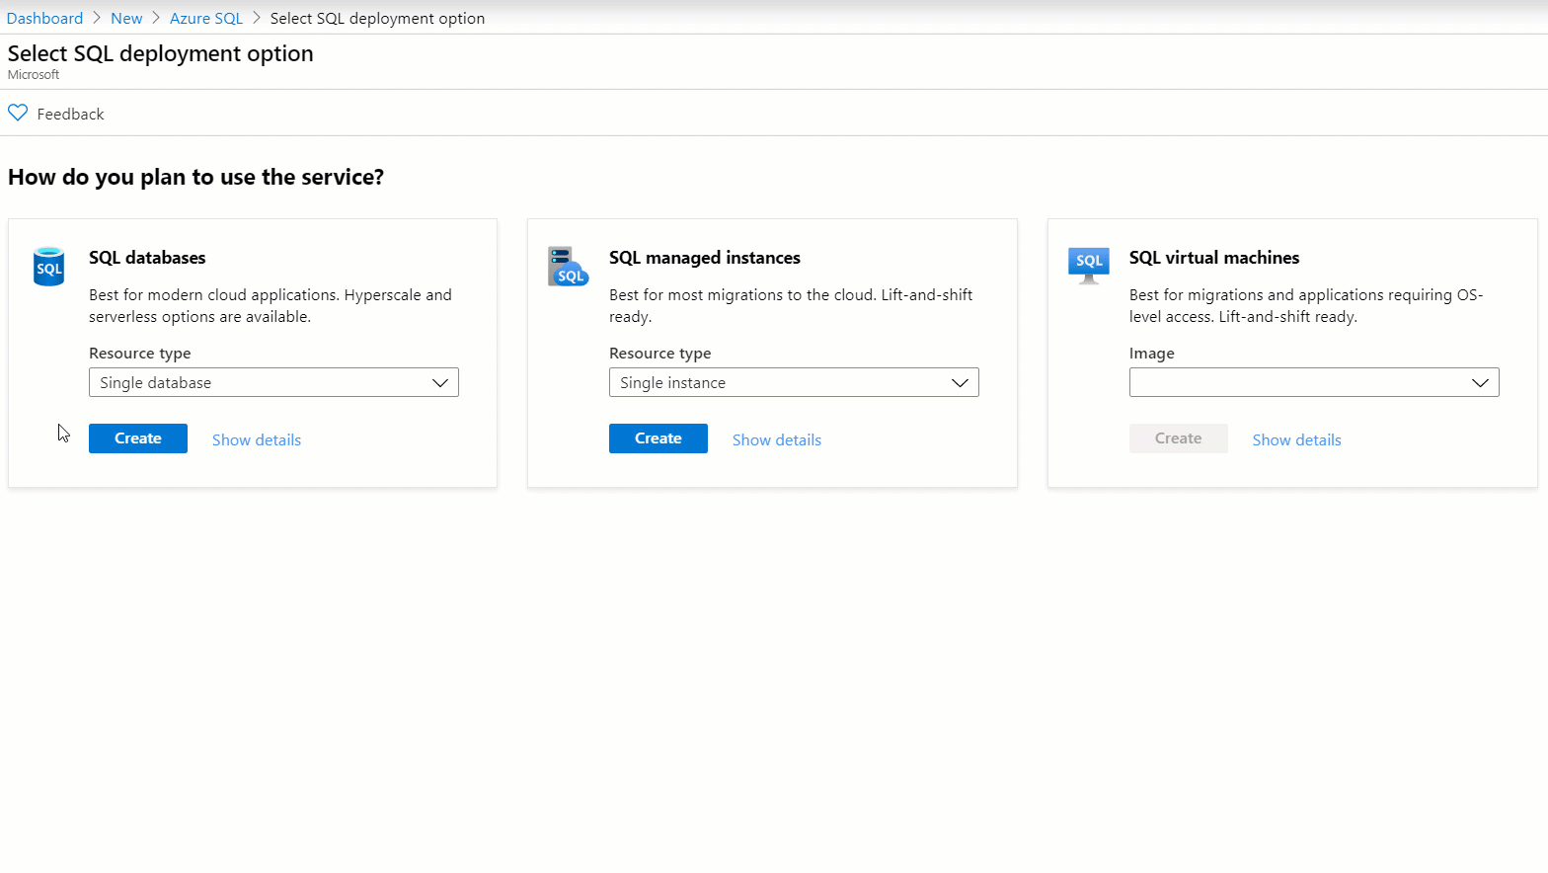
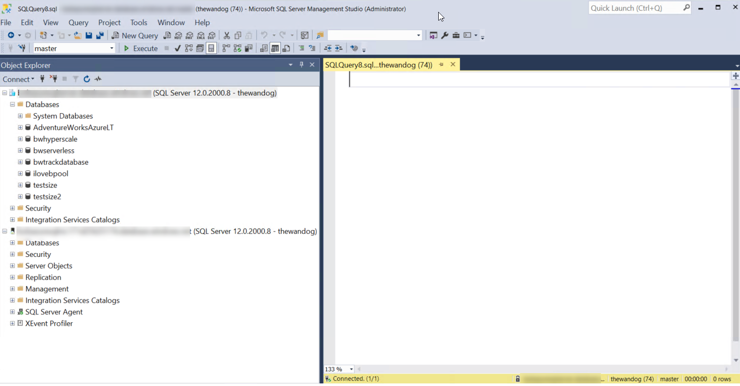
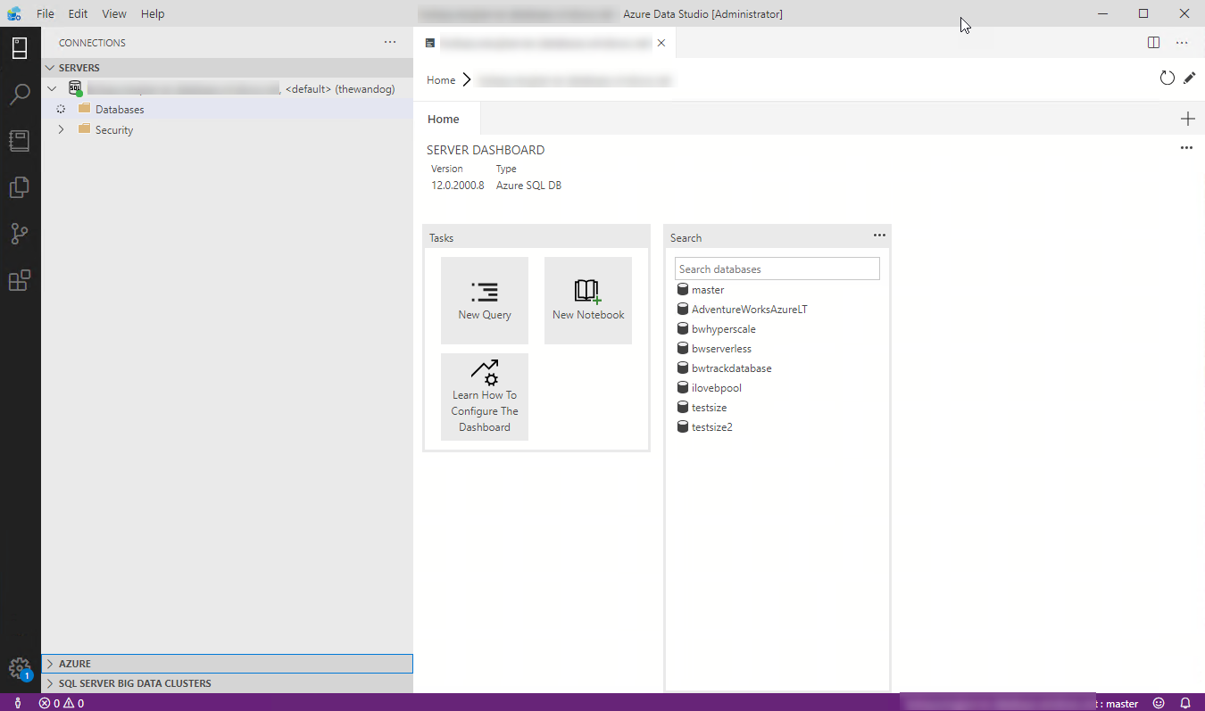


Interfaces for Azure SQL
T-SQL
Powershell
az cli
REST API
sqlcmd
bcp
Overview
SQL Server on Azure VMs
Azure SQL MI
Azure SQL Database
Comparison and summary

Slide 20
Summary
Azure SQL has evolved into the world’s database
Azure SQL includes Virtual machine, Managed Instance, and Database
SQL Server on Azure Virtual Machines is best for 100% lift and shift
Azure SQL Managed Instances: Database engine instance + power of PaaS
Azure SQL Database for modern cloud apps providing you the most PaaS capabilities
Overview
SQL Server on Azure VMs
Azure SQL MI
Azure SQL Database
Comparison and summary

Slide 21
Deploy and configure
Module 2
Pre-deployment planning
Deploy
Configure
Load
Summary

Slide 22
New deployment vs. Migration
New?
Existing?
Post-migration
Pre-migration
Migration
Optimize
Based on the tests you performed, address any performance issues, and then retest to confirm the performance improvements
Remediate applications
Iteratively make any necessary changes to your applications
Discover
Assess
Convert
Migrate schema, data & objects
Data sync
Cutover
Inventory database assets, and application stack discovery
Assess workloads and fix recommendations
Convert the source schema to work in the target environment. This is only relevant for heterogeneous migrations.
Sync your target schema and data with the source. This is only relevant for minimal-downtime migrations
Cut over from the source to the target environment. This
is only relevant for minimal-downtime migrations.
Migrate the source schema, and then migrate the source data to the target
Run functional & performance tests
Iteratively run functional and performance tests
aka.ms/AMP
Pre-deployment planning
Deploy
Configure
Load
Summary

Slide 23


Pre-deployment planning
Portal
Scripts
Deployment method
Deployment option
Region
vCores
GEN 5
FUTURE
2 4 6
General
purpose
Business Critical
Hyperscale*
Data max size
DTU*
vCore
64 GB
Purchasing model
Service tier (SLO)
Hardware
Size
*Not in managed instance
Pre-deployment planning
Deploy
Configure
Load
Summary
Notes:
Select deployment method: Platform, GUI, unattended, offline, CLI, T-SQL (Databases)
Select deployment option: single DB, elastic pool, single instance, instance pool
Select Region
Select purchasing model: DTU or vCore
Select service tier: General purpose, Business critical, or Hyperscale
Select hardware: Gen4, Gen5, M or Fsv series
Determine sizing: number of vCores and max data size
Select deployment method
Select deployment option
Select purchasing model
Select service tier
Select hardware
Determine sizing
Requesting quota increases to ask for more capacity for subscription and/or in a region
Region Notes:

Slide 24
Resource limit considerations
Memory
Max Log Size
Size of Tempdb
Max concurrent workers
Backup Retention
Pre-deployment planning
Deploy
Configure
Load
Summary
Notes:
Aside from limits, rates, and features discussed in Module 1 (like IOPS, Log Rates, or In-Memory OLTP) there are other resource limits which are affected by your choice of MI, DB, or deployment choices within these. The list on this slide shows some of these limits that may affect your choice.
Azure SQL Managed Instance
These limits for Azure SQL Managed Instance are based on your choice of General Purpose, Business Critical, and # of vCores within each tier. For a complete list of limits, please see https://docs.microsoft.com/en-us/azure/sql-database/sql-database-managed-instance-resource-limits.
Azure SQL Database
These limits are based on your purchasing model, service tier, and #vCores (if you use the vCore model), and hardware generation. Serverless and Provisioned compute choice can also affect these sizes. This resource defines limits for these for vCore service tier choices: https://docs.microsoft.com/en-us/azure/sql-database/sql-database-vcore-resource-limits-single-databases
Long-term backup storage retention today is only in limited preview for Azure Managed Instance and only 7 days for Hyperscale today.
It is also important to note that Azure SQL Database and Managed Instance have overall resource limits per subscription per region. You can read more about Azure SQL Database overall resource limits at https://docs.microsoft.com/en-us/azure/sql-database/sql-database-resource-limits-database-server#maximum-resource-limits. Managed Instance is documented at https://docs.microsoft.com/en-us/azure/sql-database/sql-database-managed-instance-resource-limits#regional-resource-limitations. If you need to increase you limits for either of these you can request a quote increase through the Azure Portal at https://docs.microsoft.com/en-us/azure/sql-database/quota-increase-request.

Slide 25
Deploy
Basics
Subscription
Resource group
Managed Instance/ Server name
Database Name (DB)
Admin Login
Password
Region
Opt-in for pools (DB)
Compute + storage
Network connectivity
Public vs Private access
VNet / Firewall rules
Connection type (MI)
Additional settings
Data source (DB)
Server Collation (MI)
Database Collation (DB)
Time zone (MI)
Opt-in for Advanced data security (DB)
Tags (DB)
Review & create
Terms and Privacy
Pre-deployment planning
Deploy
Configure
Load
Summary
Notes:
DB:
Basics
Subscription
Resource Group
Database name
Server
Server name
Server admin login
Password
Location
Elastic pool?
Compute and storage
Purchasing model
Service tier
Compute tier
Compute hardware
vCores
Data max size
Networking
Network connectivity method – None, public, private
Firewall rules
Additional Settings
Data source
Database collation
ADS
Tags
Review + create
MI:
Basics
Subscription
Resource group
Managed instance name
Region
Compute and storage
Service tier
vCores
Storage size
MI admin login
Password
Networking
Virtual network
Connection type
Public endpoint
Additional Settings
Server Collation
Time zone
Geo-repl secondary?
Review + create

Slide 26
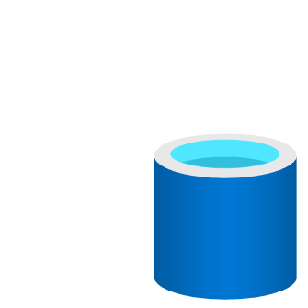
Key Deployment Implementation Details
Azure SQL Managed Instance
Dedicated ring or Virtual Cluster
Deployment and scale longer operations
Each instance = single VM
Multiple VMs per node
Pools faster deployment+density
Azure SQL Database
Contained by a logical Database Server
Logical Master database
Dedicated SQL Instance behind the scenes
More surface area and instance level diagnostics
Hyperscale
Cannot change tier once deployed
Caches provide speed and scale
Remote storage allows for snapshot backups
Resource Governance
Resource Governor
Windows Job Objects
File Server Resource Manager (FSRM)
Transaction Log Rates
Azure Storage Limits
sys.dm_os_job_object
Azure Service Fabric
Pre-deployment planning
Deploy
Configure
Load
Summary
Notes:
Details of “Contained by a logical Database Server” can be found at https://docs.microsoft.com/en-us/azure/sql-database/sql-database-servers.
The only time multiple databases might be in the same instance for the same logical server are sub-cores (Basic, S0-S2) in DTU Standard, and elastic pools in all editions and models.
“More surface area…” includes column-store and DMVs.

Slide 27

Verify Deployment
Managed Instance
SQL Database
SELECT @@VERSION
SELECT * FROM sys.databases
SELECT * FROM sys.objects
SELECT * FROM sys.dm_os_schedulers
SELECT * FROM sys.dm_os_sys_info*
SELECT * FROM sys.dm_os_process_memory*
SELECT * FROM sys.dm_exec_requests
SELECT SERVERPROPERTY('EngineEdition')
SELECT * FROM sys.dm_user_db_resource_governance
SELECT * FROM sys.dm_os_job_object
Check managed instance status with Azure portal or Azure CLI
Check Deployment details and Activity Log
Check ERRORLOG
Connect with SSMS
Connect with SSMS
Run “verify deployment” queries
Network
Name
Connect
Run “verify deployment” queries
*Not supported in SQL Database
Pre-deployment planning
Deploy
Configure
Load
Summary

Slide 28
Configure
Configuring MI
Configuring databases
Restricted configuration choices
SNAPSHOT_ISOLATION_STATE
sp_configure
Trace Flags
Tempdb
Model and master
“Edition”
Networking configuration
Space Management
ALTER DATABASE
File Maintenance (MI only)
SET options
“Edition”
dbcompat
ALTER DATABASE SCOPED CONFIGURATION
SQL DB:
“Stale” page detection
Collations
Default options ON (right)
Networking configuration
Space Management
Servers cannot be stopped or restarted
Instant File Initialization
Locked Pages in Memory
FILESTREAM and Availability Groups
Server Collation
Startup Parameters
ERRORLOG Configuration
Error Reporting and Customer Feedback
ALTER SERVER CONFIGURATION
“Mixed Mode” security is forced
Logon Audit done through SQL Audit
Server Proxy account N/A
READ_ COMMITTED_ SNAPSHOT
FULL RECOVERY
CHECKSUM
QUERY_ STORE
TDE
ACCELERATED_DATABASE_RECOVERY
Pre-deployment planning
Deploy
Configure
Load
Summary
Notes:
IFI could present a security concern (especially since you have no way to disable it if we enabled it). Plus IFI not compat with TDE which is default
We are looking to enable locked pages in memory in some cases (Ex. M-Series)

Slide 29
Azure SQL space management
Azure SQL Managed Instance
Max storage for instance – vCores affect max storage (Business Critical = less size)
Databases created as model default size (100Mb/8Mb and configurable)
You can alter size and # files but not physical location
Msg 1105 for database or Msg 1133 for max instance storage
General Purpose Remote Storage performance can be affected by data/log file size
Azure SQL Database
Data max size or MAXSIZE is the max possible size of a single database file (only 1 allowed)
Database file “maxsize” may grow to “Data max size”
Hyperscale creates db of 40Gb and grows automatically
Transaction Log maximum is 30% above “Data max size”
Log regularly truncated due to automatic backups (ADR on by default)
Pre-deployment planning
Deploy
Configure
Load
Summary
Notes:
Azure GP MI file size performance details can be found at https://medium.com/azure-sqldb-managed-instance/increasing-data-files-might-improve-performance-on-general-purpose-managed-instance-tier-6e90bad2ae4b.
An example of Database file “maxsize” may grow to “Data Max Size” is a GP 1TB database deployed. When you do this sys.database_files.max_size is ~500Gb not 1TB. As the database approaches the “data max size” the database file maxsize will grow up to the 1TB level.
Transaction Log 30% rule does not apply to Hyperscale

Slide 30
SQL connectivity architecture
WEST US
23.99.34.75
mysqldbsrv.database.windows.net
GW
GW
westus1-a.control.database.windows.net
104.42.238.205,1433
104.42.238.205
GW
GW
proxy
GW
(1) redirect-find-db
GW
GW
(2) redirect-query
..westus1-a.worker.database.windows.net
13.123.237.158, [11000 -11999]
Pre-deployment planning
Deploy
Configure
Load
Summary
Notes:
https://docs.microsoft.com/en-us/azure/sql-database/sql-database-connectivity-architecture
Key points:
Explain from perspective of a client connection
Proxy/Redirect are server level settings apply to all databases
Clients need specific connectivity for Redirect to work – port range plus all Azure Ips in a region

Slide 31
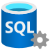
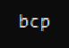


Load data
Bulk copy program
Bulk insert
Azure SSIS
Azure Data Factory
Spark connectors
Database copy
Restore natively (MI only)
Pre-deployment planning
Deploy
Configure
Load
Summary
Notes:
bcp
Connect to Azure SQL from on-premises
Connect to Azure SQL from Azure Virtual Machine
BULK INSERT
Use Azure Blob Storage
SSIS packages
Connect with SSIS on-premises
Host SSISDB in Azure SQL Database or Managed Instance
Use the Azure-SSIS Integration Runtime (IR) for SSIS packages
Using Spark to load data
Using Azure Data Factory
Create database from a copy
Anna notes: also could use ADF (MI and DB) https://docs.microsoft.com/en-us/azure/data-factory/connector-sql-server
Anna notes: could also use Spark: https://techcommunity.microsoft.com/t5/datacat/turbo-boost-data-loads-from-spark-using-sql-spark-connector/ba-p/305523

Slide 32
Loading data in Azure SQL
Consider loading files from Azure Blob Storage
Minimal logging not supported (except in tempdb)
You could be affected by transaction log rate resource governance
Be sure to use the right batch sizes for bulk copy
Take advantage of loading into a clustered columnstore index
Pre-deployment planning
Deploy
Configure
Load
Summary

Slide 33
Summary
Plan your Azure SQL, service tier, and core choices
Migrate existing data using tools
Deploy with the Azure portal or CLI using various options
Connect and verify deployment using proven methods
Configure Instances or databases including networking
Load data using traditional methods, Spark, or ADF
Pre-deployment planning
Deploy
Configure
Load
Summary

Slide 34
Activity 1: Deploy Azure SQL Database Activity 2: Initial connect and comparison Activity 3: Verify deployment (Bonus) Activity 4: Configure with Azure CLI (Bonus) Activity 5: Load data

Slide 35
Security
Module 3
Overview
Network security
Identity and access
Data protection
Monitoring, logging, and auditing
Summary

Slide 36
Security capabilities and tasks
Security capabilities
Security tasks
Active Directory Authentication
Azure RBAC and locks
Auditing
Data encryption
Dynamic Data Masking
Advanced Data Security
Setup and configure network Security
Setup and configure data protection
Setup and configure authentication and authorization
Monitoring security
Overview
Network security
Identity and access
Data protection
Security management
Summary

Slide 37
Azure SQL Enterprise-class security
Network security
VNET
Firewall Rules, NSG
Private Link
Identity
and access
Authentication options: Azure AD, SQL Auth, Windows Auth
Azure RBAC
Roles & Permissions
Row-level security
Data protection
Encryption-in-use (Always Encrypted)
Encryption-at-rest (TDE)
Encryption-in-flight (TLS)
User-managed keys
Dynamic Data Masking
Security management
Advanced Threat Detection
SQL Audit
Audit Integration with Log Analytics and Event Hubs
Vulnerability Assessment
Data Discovery & Classification
Azure Security Center
Overview
Network security
Identity and access
Data protection
Security management
Summary

Slide 38
Network security – SQL Database
Allow access to Azure services
VMVNET-EUS
VNET Peering
Firewall Rules
US EAST
SQLDBVNET-EUS
No access to Internet
Virtual Network Rules
US EAST
Private Link
Azure VM
10.0.0.3
127.33.201.5
VMVNET-WUS
Azure VM
174.17.218.16
US WEST
10.0.0.2
10.0.0.5
mysqldbsrv.database.windows.net
Private Endpoint
westus1-a.control.
database.windows.net
104.42.238.205
mysqldbsrv.privatelink.
database.windows.net
10.0.0.5
Azure VM
102.14.157.9
10.0.0.1
VNET Gateway
VNET Gateway
Vnet2Vnet
P2S, S2S VPN Express Route
On-premises
Overview
Network security
Identity and access
Data protection
Security management
Summary
Notes:
Private link:
Benefits:
Private endpoint for Azure SQL (server level)
On-premises connectivity via Express Route/VPN
Data exfiltration protection
Can be part of network monitoring strategy using a Network Virtual Appliance (NVA)
Currently in public preview for:
Azure SQL Database (singleton databases)
Azure SQL Data Warehouse
Azure Storage

Slide 39
Network security – SQL Managed Instance
VMVNET-EUS
VNET Peering
SQLDBVNET-EUS
US EAST
US EAST
Azure VM
10.0.0.3
127.33.201.5
sql-mi-2.25984.database.windows.net
Azure VM
10.0.0.254
174.17.218.16
10.0.0.5
10.0.0.2
US WEST
sql-mi-1.259fs.database.windows.net
Private Endpoint
10.0.0.252
Azure VM
MI Subnet
102.14.157.9
10.0.0.1
VNET Gateway
VNET Gateway
On-premises
Vnet2Vnet
P2S, S2S VPN Express Route
Overview
Network security
Identity and access
Data protection
Security management
Summary

Slide 40
Setup and configure network security
Azure SQL Database
Azure SQL Managed Instance
Configure Private Link if possible
Not possible?
Configure virtual network and subnet before or during deployment
Follow standard networking practices to enable connectivity
Set Allow Access to Azure services OFF
Configure Firewall rules
Configure Virtual Network rules
Overview
Network security
Identity and access
Data protection
Security management
Summary
Notes:
https://docs.microsoft.com/en-us/azure/cloud-adoption-framework/reference/networking-vdc
https://docs.microsoft.com/en-us/azure/cloud-adoption-framework/reference/vdc

Slide 41
Azure Role Based Access Control (RBAC)
All Azure operations for Azure SQL are controlled through RBAC
Think of this as security rights outside the Managed Instance or Database
Security principal and role-based system
Scope includes subscription, resource group, and resource
Decoupled from SQL Security (today)
Applies to operations in Azure portal and CLI
Allows for separation of duties for deployment, management, and usage
Azure locks help protect resources from delete or read-only
Built-in Azure SQL roles available to reduce need for owner
SQL DB Contributor
SQL Managed Instance Contributor
SQL Security Manager
SQL Server Contributor
Overview
Network security
Identity and access
Data protection
Security management
Summary
Notes:
All Azure operations for Azure SQL are controlled through RBAC
Security principal and role-based system
Scope includes subscription, resource group, and resource
Decoupled from SQL Security (today)
Applies to operations in Azure portal and CLI
Allows for separation of duties for deployment and Azure SQL management and usage
Azure locks help protect resources from delete or read-only
Built-in roles available to reduce need for higher level Azure RBAC roles like Owner or Contributor. So effectively, you can use these roles to have certain individuals deploy Azure SQL resources (or manage security polices) but grant other users actual access to user or manage the MI or database. For example, a Server contributor could deploy a server but assign an Azure DB user to be the admin of the server and databases.
SQL DB Contributor – Can create and manage database but access the database (Ex. to connect and read data)
SQL Managed Instance Contributor – Create and manage managed instances but not access them
SQL Security Manager - Manage security policies for MI and databases (like auditing) but not access the MI or database
SQL Server Contributor – Manage servers and databases but not access them.

Slide 42
Authentication to Azure SQL
“Mixed Mode” authentication forced
SQL Auth for deployment: server admin
Server-level principal for logical server for DB
Member of sysadmin server role for MI
Need Windows Auth? Use Azure AD Authentication
Azure Managed Instance
Azure AD Server Admin
SQL or Azure AD Logins
Database Users
SQL Server Contained Database supported
Azure SQL Database
Azure AD Server Admin
SQL logins
loginmanager and dbmanager roles for limited server admins
Database Users
Contained Database Users including Azure AD (recommended)
Overview
Network security
Identity and access
Data protection
Security management
Summary
Notes:
“Mixed Mode” authentication forced and cannot be changed
SQL Auth login required during deployment called server admin.
Server-level principal for logical server. Becomes default dbo for Azure SQL Database
Member of sysadmin server role for Managed Instance
Need Windows Auth? Use Azure Active Directory Authentication
CREATE LOGIN supported for both MI and Database
loginmanager and dbmanager roles for Azure Database admins
sa disabled for Managed Instance and guest disabled for database
CREATE LOGIN has some syntax differences for MI and DB (Ex. supporting Azure AD auth). See https://docs.microsoft.com/en-us/sql/t-sql/statements/create-login-transact-sql?view=azuresqldb-current and https://docs.microsoft.com/en-us/sql/t-sql/statements/create-login-transact-sql?view=azuresqldb-mi-current.
logins for Azure SQL Database are created in the context of the logical server.
The server admin specified during database server deployment is a server level principal and effectively has “sysadmin” rights for the server and all databases.
You can create other more limited admins using the following database level roles in the master of the logical server.
loginmanager role is a database level role in the master of the logical server. Members are allowed to create logins for the database server
dbmanager is a database level role in the master of the logical server. Members can create and delete databases based on the database server.

Slide 43
Setup and configure authentication and authorization
Deploy with a SQL server admin
Create other admins
Admins can create users
Grant access just like SQL
Overview
Network security
Identity and access
Data protection
Security management
Summary
Notes:
Deploy with a SQL Server admin
Both MI and Azure SQL Database Server require a SQL Server admin account and password
Create Other Admins
For MI, you can create an Azure AD server admin which is a sysadmin for the instance
You can create other sysadmin logins either with SQL logins or with AAD
For DB, you can create an Azure AD server admin (just one)
You can now create SQL “admin” logins by placing them in the special loginmanager or dbmanager logical master database roles
Admins can create users
For MI,
Now create logins and users just like you would for any SQL Server except instead of Windows Auth you can use AAD
A SQL Server Contained Database is supported just like SQL Server
Users CAN not be based on AAD
For DB,
You can create SQL logins in logical master
You can create users in databases based SQL logins in logical master
In addition, you can create contained database users either with SQL auth or AAD (AAD requires an AAD server admin)

Slide 44
Data encryption
Encrypted connections – TLS forced for Azure SQL Database
TLS 1.2 forced for Azure SQL Managed Instance outbound connections
Column Level Encryption
Transparent Data Encryption (TDE) for data at rest (on by default for Database)
Always Encrypted for data in use
Integration with Azure Key Vault (BYOK)
plaintext
ciphertext
Enhanced client driver
Overview
Network security
Identity and access
Data protection
Security management
Summary
Notes:
Encrypted connections
Encrypted connections required and forced using TLS
Force encryption on client to avoid server negotiation
Don’t trust server certificate as best practice
Transparent Data Encryption (TDE)
On by default for all new Azure SQL Databases
Customer-managed keys with Azure Key Vault
Column Level Encryption
Supported just like SQL Server
Always Encrypted
Supported just like SQL Server
Store keys in Azure Key Vault
Enclave support not yet available
Always encrypted
Client side Encryption-Client-side encryption of sensitive data using keys that are never given to the database system
Encryption Transparency-Client driver transparently encrypts query parameters and decrypts encrypted results
Queries on Encrypted Data-Support for equality comparison, including join, group by and distinct operators via deterministic encryption

Slide 45
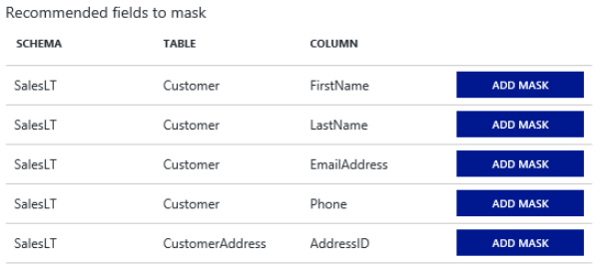
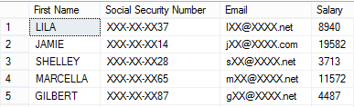
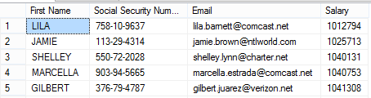
Dynamic Data Masking
ALTER TABLE [Employee] ALTER COLUMN [SocialSecurityNumber]
ADD MASKED WITH (FUNCTION = 'Partial(0,"XXX-XX-",2)')
ALTER TABLE [Employee] ALTER COLUMN [Email]
ADD MASKED WITH (FUNCTION = ‘EMAIL()’)
ALTER TABLE [Employee] ALTER COLUMN [Salary]
ADD MASKED WITH (FUNCTION = ‘RANDOM(1,20000)’)
GRANT UNMASK to DataOfficers
Normal Endusers
Role DataOfficers
Overview
Network security
Identity and access
Data protection
Security management
Summary

Slide 46
Setup and configure data protection
Ensure applications force connection encryption
Evaluate use of TDE
Take advantage of Dynamic Data Masking
Setup Always Encrypted for advanced protection
Overview
Network security
Identity and access
Data protection
Security management
Summary
Notes:
Ensure applications force connection encryption
Setup Always Encrypted for advanced protection

Slide 47
Auditing in Azure SQL
Audit Azure Level Activities with Azure Monitor Logs
SQL Server Audit used for Azure SQL Managed Instance
Logs stored in Azure Blob Storage
Azure Monitor Logs and Event Hub supported
Failure or Continue options (but not Shutdown)
Azure SQL Auditing for Azure SQL Database
Powered by SQL Server Audit
Server and Database Audit Action Groups and Actions supported
Store and Analyze Audits:
Azure Log Analytics with Dashboard
Azure Storage account
Azure Event Hubs
Overview
Network security
Identity and access
Data protection
Security management
Summary
Notes:
SQL Server Audit for Azure SQL Managed Instance
Works just like SQL Server except for storage is Azure Blog Storage for .xel files
Azure SQL Auditing
Default action groups are BATCH_COMPLETED_GROUP, SUCCESSFUL_DATABASE_AUTHENTICATION_GROUP, FAILED_DATABASE_AUTHENTICATION_GROUP
No exact Audit-Level Audit Action Group equivalent capability but some is available through Activity Logs and BATCH_COMPLETED_GROUP audit

Slide 48
Monitoring and managing security
Use Activity Logs and RBAC auditing for Azure monitoring
Azure Managed Instance
Configure SQL Server Audit for Azure Managed Instance
Engine can track for failed/successful logins in Azure Managed Instance
Azure SQL Database
Configure Azure SQL Auditing for Azure Database
DMVs, Metrics, and Alerts to monitor security events for Azure Database
sys.event_log
# Successful or Failed Connections
# Blocked by Firewall
Setup alerts for Advanced Threat Protection
Monitor Azure Security Center
Overview
Network security
Identity and access
Data protection
Security management
Summary

Slide 49
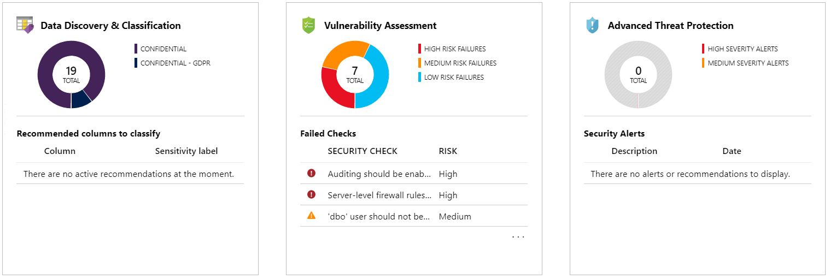
Advanced data security
Overview
Network security
Identity and access
Data protection
Security management
Summary

Slide 50
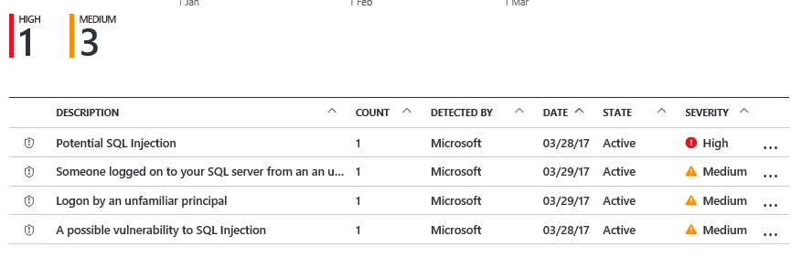

Advanced Threat Protection Detect unusual and harmful attempts to breach your database
Attacker
Detects potential SQL injection attacks
Detects unusual access & data exfiltration activities
Actionable alerts to investigate & remediate
View alerts for your entire Azure tenant using Azure Security Center
Possible threat to
access / breach data
User
Apps
Azure SQL Database
Developer
Audit Log
Threat Detection
Turn on Threat Detection
Real-time actionable alerts
Overview
Network security
Identity and access
Data protection
Security management
Summary
Notes:
To summarize what you have seen, SQL Threat Detection allows you to respond to unusual and harmful attempts to breach your database.
1) It is super simple to enable and requires no modifications to your application code.
2) It provides you with a set of world-class algorithms that learn, profile and detect potential SQL injections and unusual behavior patterns.
3) It triggers security alerts upon detection, which include clear description and actionable investigation and remediation steps.

Slide 51
Summary
Be aware of the security capabilities Azure SQL brings to the table
Select the authentication method that works for your organization
Configure your network to allow connections from the right places only
Protect your data with Data Encryption best practices
Leverage Advanced data security to monitor, manage, and address security concerns
Overview
Network security
Identity and access
Data protection
Security management
Summary

Slide 52
Activity 1: Configure Auditing Activity 2: Configure and manage Firewall/Vnet rules (Bonus) Activity 3: Create and manage Private Link Activity 4: Azure AD authentication (Bonus) Activity 5: Confirm TDE is enabled Activity 6: Advanced data security (Bonus) Activity 7: Data classification, Dynamic data masking, and SQL Audit

Slide 53
Performance
Module 4
Overview
Configuration and maintenance
Monitoring performance
Performance scenarios
Accelerating and tuning
Intelligent performance

Slide 54
Performance Capabilities and Tasks
Performance capabilities
Performance tasks
Memory, CPU, I/O capacities
Indexes
In-Memory OLTP
Partitions
Intelligent Performance
Configuring and Maintaining for Performance
Monitoring and Troubleshooting Performance
Performance Scenarios
Accelerating and Tuning Performance
Overview
Configuration and maintenance
Monitoring performance
Performance scenarios
Accelerating and tuning
Intelligent performance

Slide 55
Azure SQL performance capabilities
Max capacities
Azure SQL Database - Up to 128 vCores and 4TB Memory and 4TB Database (data)
Hyperscale – 100TB Max Database Size
Managed Instance – Up to 80 vCores, 400GB Memory, and 8TB Database (data)
sys.dm_os_job_object for true capacities
Indexes
All index types are supported
Online and resumable indexes fully supported
Columnstore Indexes available in almost all tiers
In-memory OLTP
Available in Business Critical Tiers
Memory Optimized FILEGROUP created with database creation
Max memory a portion of overall memory limit
Partitions
Supported for both Azure SQL Database and Managed Instance
Placement on filegroups only supported for Managed Instance
SQL Server 2019 performance enhancements
Not 100% in Azure SQL (today)
Intelligent Query Processing (except for Scalar UDF Inlining)
Overview
Configuration and maintenance
Monitoring performance
Performance scenarios
Accelerating and tuning
Intelligent performance
Notes:
Gen5: 20.4 GB - 408 GB (5.1GB/vCore) for read-write queries + additional 20.4 GB - 408 GB (5.1GB/vCore) for read-only queries. Add more vCores to get more memory.
Max Capacities
Azure SQL Database - Up to 128 vCores and 4TB Memory and 4TB Database (data)
Hyperscale – 100TB Max Database Size
Managed Instance – Up to 80 vCores, 400GB Memory, and 8TB Database (data)
Use sys.dm_os_job_object for match true capacities.
Indexes
All index types are supported across Azure SQL
Online and resumable indexes fully supported
Columnstore Indexes available in almost all tiers.
In-Memory OLTP
Available in Business Critical Tiers
Memory Optimized FILEGROUP created with database creation
Max memory a ration of overall memory limit
Partitions
Supported for both Azure SQL Database and Managed Instance
Placement on filegroups only supported for Managed Instance
New SQL Server 2019 Performance enhancements
Many of the performance enhancements in SQL Server 2019 are available in Azure SQL. Check the documentation for each option. https://docs.microsoft.com/en-us/sql/sql-server/what-s-new-in-sql-server-ver15?view=sql-server-ver15

Slide 56
Configuring for performance
Tempdb
Always kept on local SSD drives
For DB, # files scales with vCores
You get 12 files with MI
MIXED_PAGE_ALLOCATION IS OFF
AUTOGROW_ALL_FILES is ON
Tempdb Metadata Optimization not supported
Database
Only full recovery supported so minimal logging for bulk operations not possible
Files and Filegroups
MI supports adding files and sizes but not physical placement
# files and file size can be used to tune I/O performance
User defined FILEGROUP only supported for MI
MAXDOP
ALTER DATABASE SCOPED CONFIGURATION
sp_configure supported for MI
Query hints allowed
MI supports RG
Resource Governor
User defined Managed Instance only
Overview
Configuration and maintenance
Monitoring performance
Performance scenarios
Accelerating and tuning
Intelligent performance
Notes:
Configuring Tempdb
Always kept on local SSD drives so I/O perf shouldn’t be an issue
For Azure DB (vCores), we scale # files with vCores (2vcores=4 files,…) max of 16.
You get 12 files with MI independent of vCores We are looking to allow user config for this in the future.
MIXED_PAGE_ALLOCATION IS OFF and AUTOGROW_ALL_FILES is ON for tempdb
Tempdb Metadata Optimization not supported
Database Configuration
Only full recovery supported so minimal logging for bulk operations not possible
Configuring Files and Filegroups
MI supports adding files and sizes but not physical placement
# files and file size can be used to tune I/O performance. Read more here. https://techcommunity.microsoft.com/t5/datacat/storage-performance-best-practices-and-considerations-for-azure/ba-p/305525
User defined FILEGROUP not supported but you can’t physically place files anyway.
Configuring MAXDOP
ALTER DATABASE SCOPED CONFIGURATION for DB and MI
sp_configure supported for MI
Query hints allowed
MI supports RG
Server Configuration Optimized for ad hoc workloads supported in MI but not in DB

Slide 57
Maintaining for performance
Maintaining indexes
REBUILD and REORG
Maintaining statistics
Automatic Stats
Overview
Configuration and maintenance
Monitoring performance
Performance scenarios
Accelerating and tuning
Intelligent performance
Notes:
Maintaining Indexes
REBUILD and REORG fully supported for DB and MI
Maintaining Statistics
Automatic Stats supported for DB and MI just like SQL Server
Note: Maintenance Plans in SSMS are not available in DB or MI

Slide 58
Monitoring and Troubleshooting Performance
Azure Monitor Metrics, Alerts, and Logs
Dynamic Management Views
Extended Events
Lightweight Query Profiling on by default
Query Plan Debugging with SET statements
Query Store on by default
Performance Visualizations in portal
?
Query store
Queries
SQL Database
SQL Managed Instance
Deeper insight
Overview
Configuration and maintenance
Monitoring performance
Performance scenarios
Accelerating and tuning
Intelligent performance
Notes:
Azure Monitor Metrics and Logs
Metrics and events specific to Azure SQL
Metrics and events for Azure resources
Dynamic Management Views
For Azure SQL Database many of these need to run in the context of the user database.
Some DMVs unique to Azure
Number of DMVs available different for SQL Server, Azure SQL DB, and MI
Query Store
Performance Overview and Query Performance Insights in portal uses Query Store
Catalog views and SSMS Reports work just like SQL Server
Extended Events
Azure SQL DB supports file, ring_buffer, and counter targets. File targets stored in Azure Blob Storage
Azure MI supports all targets of SQL Server
Azure SQL DB supports a subset of SQL Server events plus Azure specific events
Azure SQL MI supports all SQL Server events plus other Azure specific events
As of 2/23/2020 Azure SQL MI supports 2400+ events. SQL Server 2019 has 1800+ events
Azure SQL DB supports 392 events
Azure SQL DB has 202 DMVs
Azure SQL MI has 323 DMVs
SQL Server 2019 has 273 DMVs

Slide 59
Dynamic Management Views
Azure SQL Managed Instance
All SQL Server DMVs available
sys.server_resource_stats
Azure SQL Database
Common SQL Server DMVs available
sys.dm_db_resource_stats
sys.elastic_pool_resource_stats
You will need these
sys.dm_io_virtual_file_stats
sys.dm_os_performance_counters
sys.dm_instance_resource_governance
sys.dm_user_db_resource_governance
Geek out
sys.dm_user_db_resource_governance_internal
sys.dm_resource_governor_resource_pools_history_ex
sys.dm_resource_governor_workload_groups_history_ex
Overview
Configuration and maintenance
Monitoring performance
Performance scenarios
Accelerating and tuning
Intelligent performance
Notes:
Azure Monitor Metrics and Logs
Metrics and events specific to Azure SQL
Metrics and events for Azure resources
Dynamic Management Views
For Azure SQL Database many of these need to run in the context of the user database.
Some DMVs unique to Azure
Number of DMVs available different for SQL Server, Azure SQL DB, and MI
Query Store
Performance Overview and Query Performance Insights in portal uses Query Store
Catalog views and SSMS Reports work just like SQL Server
Extended Events
Azure SQL DB supports file, ring_buffer, and counter targets. File targets stored in Azure Blob Storage
Azure MI supports all targets of SQL Server
Azure SQL DB supports a subset of SQL Server events plus Azure specific events
Azure SQL MI supports all SQL Server events plus other Azure specific events
MSONLY Note: Azure SQL Database Intelligent Insights and Azure SQL Analytics are in preview but have been for some time. This will be in the notes and mentioned but not emphasized.
As of 2/23/2020 Azure SQL MI supports 2400+ events. SQL Server 2019 has 1800+ events
Azure SQL DB supports 392 events
Azure SQL DB has 202 DMVs
Azure SQL MI has 323 DMVs
SQL Server 2019 has 273 DMVs

Slide 60
Extended events with Azure SQL
Azure SQL Database
Most common events and actions
File (Azure Blob Storage), ring_buffer, and counter targets
Azure SQL Managed Instance
All events, targets, and actions supported
File targets to Azure Blob Storage
Azure MI supports all SQL Server events plus Azure specific events
Overview
Configuration and maintenance
Monitoring performance
Performance scenarios
Accelerating and tuning
Intelligent performance

Slide 61
It is just SQL: Running or waiting
sys.dm_db_resource_stats,
sys.server_resource_stats,
Portal/Powershell/Alerts
Check resource consumption
Running (CPU)
Waiting
Execution
Compilation
IO Waits
Lock Waits
Latch Waits
Buffer pool limits
Memory Grants
Plan cache eviction
… Others
Query Store,
dm_exec_requests,
SOS_SCHEDULER_YIELD waits,
dm_exec_query_stats,
dm_exec_procedure_stats
sys.dm_os_wait_stats ,
sys.dm_exec_requests,
sys.dm_os_waiting_tasks,
Query Store
Overview
Configuration and maintenance
Monitoring performance
Performance scenarios
Accelerating and tuning
Intelligent performance
Notes:
Use Running vs Waiting as you would SQL Server
Resolve blocking and deadlocking just as you would SQL Server
High CPU typically requires query tuning or more CPUs resources
PAGEIOLATCH and WRITELOG high wait times may require
Change Pricing Tier to get better IOPs and/or latency.
For Managed Instance, # files and/or file size can help with IOPs and I/O throttling
Business Critical is always the best for I/O sensitive applications
You may not have enough memory so move up tier or cores to get more
Applications may not be tuned such as singleton transactions or scans
PAGELATCH waits are just like SQL Server.
Databases use indirect checkpoints
Buffer Pool Limits
Target is set to around “limit” in the docs – 3Gb. (3Gb is reserved for other memory requirements of the database and instance)
You cannot control max or min server memory
Managed Instance supports RG
Memory Grants
Over and underestimate can still be an issue
There is no RG control for this except in MI
Plan Cache Eviction
FORCED_PARAMETERIZATION supported for DB and MI
Optimized for ad hoc workloads supported in MI but not in DB

Slide 62
Azure specific performance scenarios
Log governance
LOG_RATE_GOVERNOR wait for Azure SQL Database
POOL_LOG_RATE_GOVERNOR wait for Elastic Pools
INSTANCE_LOG_GOVERNOR wait for Azure SQL Managed Instance
HADR_THROTTLE_LOG_RATE* wait for Business Critical and Geo-Replication latencies
Worker limits
Error when concurrent worker limit reached for Azure SQL Database
Managed Instance = SQL Server worker threads and THREADPOOL waits
Business critical HADR waits
HADR_SYNC_COMMIT
HADR_DATABASE_FLOW_CONTROL
HADR_THROTTLE_LOG_RATE_SEND_RECV
Hyperscale
RBIO* waits for log rate throttling
Page Server Reads in DMVs, catalog views, and Extended Events
Overview
Configuration and maintenance
Monitoring performance
Performance scenarios
Accelerating and tuning
Intelligent performance
Notes:
Log Governance – this is a governance of transaction log record generation rates not I/O. See this doc for more info: https://docs.microsoft.com/en-us/azure/sql-database/sql-database-resource-limits-database-server#transaction-log-rate-governance
LOG_RATE_GOVERNOR wait
INSTANCE_LOG_GOVERNOR wait
Worker Limits
Error when concurrent worker limit reached for Azure SQL Database
Managed Instance = SQL Server worker threads and THREADPOOL waits.
Be Aware Of….
Business Critical have AG replicas on by default so you may see HADR* waits
Hyperscale
For a complete set of diagnostics on Hyperscale reads the docs at https://docs.microsoft.com/en-us/azure/sql-database/sql-database-hyperscale-performance-diagnostics.

Slide 63
Accelerating and Tuning Performance
Scaling CPU Capacity
Portal, T-SQL, Powershell, or REST
Downtime (can be very fast) but no migration required
Hyperscale can scale in constant time
I/O performance
Do you know IOPS? IOPS restrictions may show up in the form of longer I/O waits
Scale up vCores or move to Business Critical/Hyperscale for higher IOPS
For faster I/O latency for DB, consider Business Critical or Hyperscale
For faster I/O latency for MI, move to Business Critical or change # files or file size
Consider multi-statement transactions for log I/O latency
Increasing Memory or Workers
For DB, scale up vCores with higher limits for more memory or workers
For MI, scale up vCores for more memory
Max worker threads for MI
Improving Application Latency
Use redirect connections and not proxy
Optimize “chatty” applications
Tune your SQL queries just like you would with SQL Server
Indexes
Batching
Stored Procs
Parameterization
Process Result Sets
Overview
Configuration and maintenance
Monitoring performance
Performance scenarios
Accelerating and tuning
Intelligent performance
Notes:
MI may make changes to limit workers in the future vs max worker threads
Note: For multi-statement transactions there could be a balance in this improving I/O latency for the transaction log and running into log rate governance. In other words, if you group too many transactions you could hit a log rate governance limit depending on your tier.
Scaling CPU Capacity
Portal, T-SQL, Powershell, or REST
Downtime (can be very fast) but no migration required
Hyperscale can scale very fast
Increasing IOPS and reducing IO latency
Do you know IOPS?
IOPs restrictions may show the form of I/O latency
For Azure DB, consider BC or Hyperscale
For MI, either move to BC or change # files or file size
Increasing Memory or Workers
For Azure DB, scale up vCores with higher limits for more memory or workers
For MI, scale up vCores for more memory
Max worker threads for MI
Improving Application Latency
Use redirect connections and not proxy

Slide 64
Intelligent Performance
Intelligent Query Processing
Automatic Plan Correction
Automatic Tuning
Overview
Configuration and maintenance
Monitoring performance
Performance scenarios
Accelerating and tuning
Intelligent performance

Slide 65
Intelligent Query Processing
Built into the Query Processor
Adapt to different workloads to improve performance with no code changes
Enabled through Database Compatibility Level
Adaptive QP = dbcompat 140
Bold = dbcompat 150
Intelligent QP
Adaptive QP
Table Variable Deferred Compilation
Batch Mode for Row Store
Approximate QP
Scalar UDF inlining
²
Adaptive Joins
Interleaved Execution
Memory Grant Feedback
Approximate Count Distinct
¹
Batch Mode
Batch Mode
Row Mode
¹Approximate Count Distinct does not require dbcompat level
²Not currently available with Azure SQL Database
Overview
Configuration and maintenance
Monitoring performance
Performance scenarios
Accelerating and tuning
Intelligent performance

Slide 66
Automatic Plan Correction
Continuous performance plan monitoring and analysis
Based on Query Store
Detect and fix problematic plans based on regressions
Fix ON by default for Azure SQL
Part of Automatic Tuning family
Results only exposed through DMV
Query times
Plan 1
Plan 2
Plan 3
Plan 2
Revert to previously effective plan
Overview
Configuration and maintenance
Monitoring performance
Performance scenarios
Accelerating and tuning
Intelligent performance

Slide 67
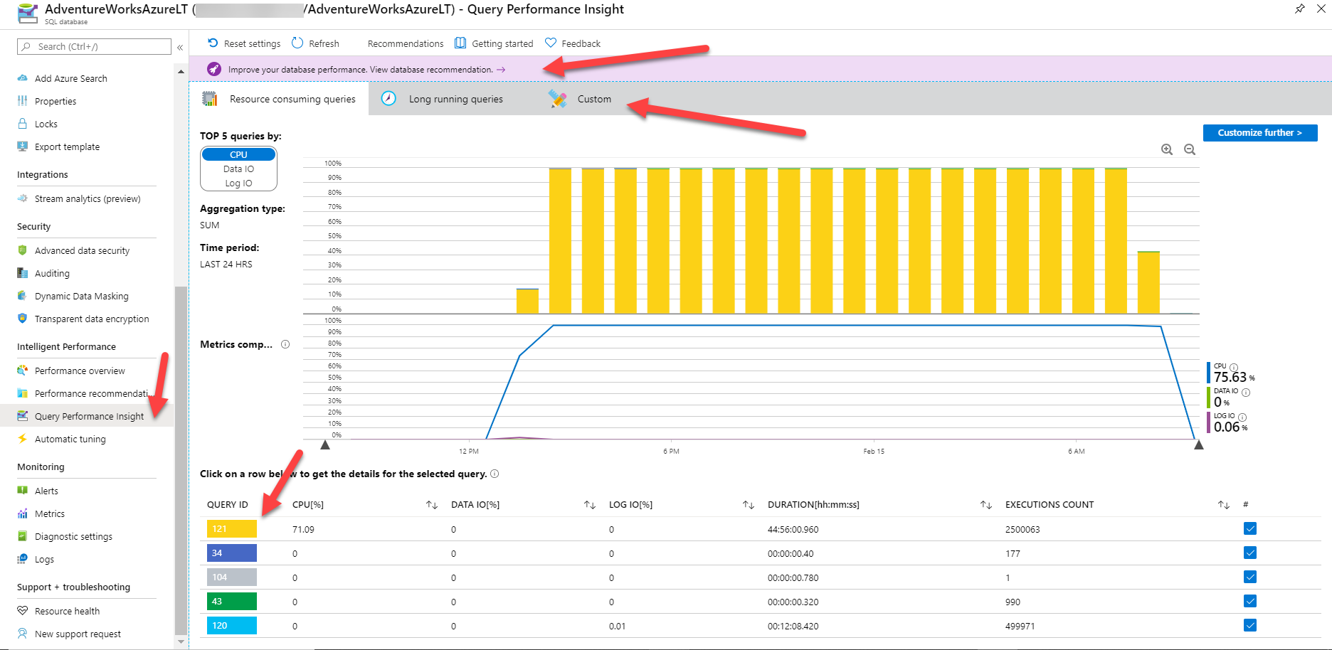
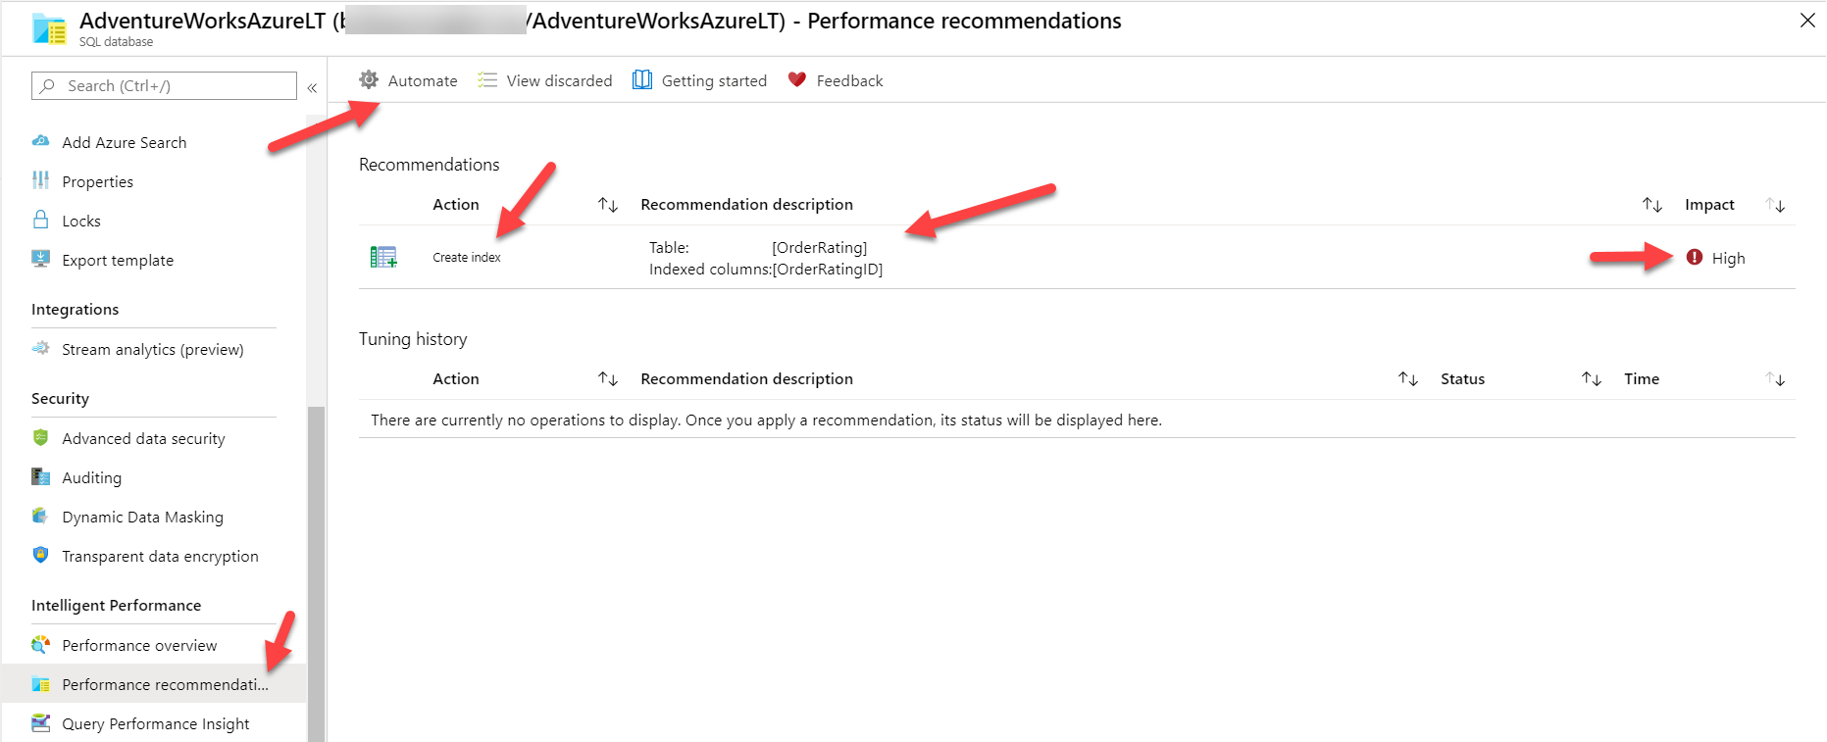
Automatic Tuning with Azure SQL Database
Index Recommendations
ML approach based on DMVs and Query Store
Parameterized Query Recommendations
View in DMVs and Azure Portal
Overview
Configuration and maintenance
Monitoring performance
Performance scenarios
Accelerating and tuning
Intelligent performance

Slide 68
Summary
Fixed capacities to choose from for CPU, memory, and I/O
Resource governance specific to Azure
Scale up and down without need to migrate
Tools exist like DMVs and Extended Events like SQL Server
New Azure functionality exists like Azure Metrics, new DMVs, new wait types
Query Store on by default
Intelligent Performance to get faster with no code changes
Overview
Configuration and maintenance
Monitoring performance
Performance scenarios
Accelerating and tuning
Intelligent performance
Notes:
Fixed capacities to choose from for CPU, memory, and I/O.
Tools exist like DMVs and Extended Events like SQL Server.
Query Store on by default and powers query tuning.
New Azure functionality exists to replace existing functionality like Azure Metrics.
DMVs exist that are new and designed for Azure.
New wait types exist specific to Azure.
Resource governance is specific to Azure.
Scale up and down without need to migrate.
Intelligent Performance to get faster with no code changes.

Slide 69
Activity 1: How to monitor performance in Azure SQL Database Activity 2: Scaling your workload performance in Azure SQL Database Activity 3: Optimizing application performance in Azure SQL Database (Bonus) Activity 4: Using Automatic Tuning in Azure SQL Database

Slide 70
Availability
Module 5
Overview
Backup and restore
Built-in HA/DR
Availability and consistency
Configuring and monitoring availability
Summary

Slide 71
Availability capabilities and tasks
Availability capabilities
Availability tasks
Auto and user-controlled BACKUP/RESTORE
Built-in HADR and read replicas
Availability Zones
Geo-replication and Failover Groups
Database Availability
Replication
Database Consistency
Choose Edition for RTO and RPO requirements
Configure HADR
Monitoring Availability
Overview
Backup and restore
Built-in HA/DR
Availability and consistency
Configuring and monitoring availability
Summary
Notes:
Replication
No separate slide here but transaction replication is supported Azure SQL Managed Instance. Merge is not supported.
Azure SQL Database can serve as a push subscriber from a SQL Server on-premises, an Azure VM, or Azure SQL Managed Instance
Note that Log Shipping is not supported to use as a feature even for MI (the underlying technology for LS is used by DMS for online migration to MI)

Slide 72
Backup and restore
Auto backups and Point in Time Restore (PITR)
Full Database backup once a week
Log Backups every 5-10 minutes
Differential Backups every 12 hours
Backup files on Azure storage with RA-GRS replicated
Backup Integrity checks
Restore to new database
Long-term retention (up to 10 years) of backups
Geo-restore of databases if primary region down
Restore backups of deleted databases
Manual COPY_ONLY Backup/Restore with Managed Instance
Backups retained for 7/35 days
Time
Now
-7 days
Self-service restore to a point in time
DB1
DB1
Overview
Backup and restore
Built-in HA/DR
Availability and consistency
Configuring and monitoring availability
Summary
Notes:
Details for Backup Integrity Checks
On an ongoing basis, the Azure SQL Database engineering team automatically tests the restore of automated database backups of databases placed in logical servers and elastic database pools. (This testing isn't available in managed instance.) Upon point-in-time restore, databases also receive DBCC CHECKDB integrity checks.
Managed instance takes automatic initial backup with CHECKSUM of databases restored with the native RESTORE command or with Azure Data Migration Service after the migration is completed.
Restore to new database
You can deploy a new database also based on a backup
Notes on LTR backups
If you enable LTR policy, the weekly full backups are automatically copied to a different RA-GRS storage container. To meet various compliance requirements, you can select different retention periods for weekly, monthly, and/or yearly backups
LTR not supported on Hyperscale today
Current limits for LTR of backups for Managed Instance
Using long-term backup retention with an Azure SQL Database managed instances has the following limitations:
Limited public preview - This preview is only available to EA and CSP subscriptions and is subject to limited availability.
PowerShell only - There is currently no Azure portal support. LTR must be enabled using PowerShell.
Restore deleted databases
You cannot restore a deletion of a logical server or managed instance. The portal only allows you to restore a deleted database back to the deletion time. You need Powershell or REST to restore a backup of a deleted database from an earlier point of time based on backup retention.

Slide 73

General Purpose High Availability
Behaves like Failover Cluster Instance
Remote storage provides data redundancy within a datacenter
Backup files are in a different location with geo-redundancy
Failover decisions based on SQL and Service Fabric
Recovery time depends on spare capacity
Connectivity redirection built-in
Azure Region
Application
GW
GW
GW
Control Ring
Primary Replica
Failover
Nodes with spare capacity
SSD, tempdb
SSD, tempdb
Data and log files
Azure premium storage (LRS) data/log
Backup files
Azure standard storage
(RA-GRS)
Overview
Backup and restore
Built-in HA/DR
Availability and consistency
Configuring and monitoring availability
Summary
Notes:
Images from docs https://docs.microsoft.com/en-us/azure/sql-database/sql-database-high-availability
Notes:
Behaves like a Failover Cluster Instance
Azure Storage handles redundancy of files (LRS)
SQL coordinates with Service Fabric for failovers
Backups on different storage with GRS
SSD Cache is Azure Blob Cache
Tempdb kept on local storage
Applies to Azure SQL Database and MI
Force failover using Powershell (see more at https://docs.microsoft.com/en-us/powershell/module/az.sql/invoke-azsqldatabasefailover?view=azps-3.8.0) or REST. There are limits on how often you can do this.
Failover Logic
Spin up a new SQL Server instance on a node with availability
Attach SQL Database files
Run Recovery
Gateways updated for new node. No virtual network or listener required

Slide 74
Business Critical High Availability
Based on Always On Availability Groups
3 secondary replicas automatically created
Four replicas kept available
Backup files in a different location with geo-redundancy
At least one secondary must sync for commits
Automatic failover based on SQL and Service Fabric
Recovery time extremely fast
Connectivity redirection built-in
Read Scale-Out from one of the replicas
Azure Region
GW
GW
GW
Application
Control Ring
Secondary Replica
Secondary Replica
SSD, data, log
SSD, data, log
Primary Replica
AlwaysON Availability Group
SSD, data, log
Failover
Secondary Replica
SSD, data, log
Backup files
Azure standard storage
(RA-GRS)
Overview
Backup and restore
Built-in HA/DR
Availability and consistency
Configuring and monitoring availability
Summary
Notes:
Image comes from https://docs.microsoft.com/en-us/azure/sql-database/sql-database-high-availability#premium-and-business-critical-service-tier-availability
Four replicas kept available
This is a major benefit to users of Azure. For SQL Server, if a failover occurs, you are responsible to getting the old primary back as a new secondary if the machine is down. In Azure, we just provision a new replica and make it a new secondary.
This is a big difference from default configuration of AGs with SQL Server
At least one secondary must sync for commits
he primary node constantly pushes changes to the secondary nodes in order and ensures that the data is synchronized to at least one secondary replica before committing each transaction. This process guarantees that if the primary node crashes for any reason, there is always a fully synchronized node to fail over to.
Read more about read scale out at https://docs.microsoft.com/en-us/azure/sql-database/sql-database-read-scale-out
Force failover using Powershell (see more at https://docs.microsoft.com/en-us/powershell/module/az.sql/invoke-azsqldatabasefailover?view=azps-3.8.0) or REST. There are limits on how often you can do this.
Important note about read replicas
Read Scale-Out supports session-level consistency. It means, if the read-only session reconnects after a connection error caused by replica unavailability, it may be redirected to a replica that is not 100% up-to-date with the read-write replica. Likewise, if an application writes data using a read-write session and immediately reads it using a read-only session, it is possible that the latest updates are not immediately visible on the replica. The latency is caused by an asynchronous transaction log redo operation.

Slide 75

Hyperscale High Availability
Paired page servers
Redundant log and data through Azure Storage
Backup/Restore snapshots
Log Service feeds replicas
0 to 4 secondary replicas for read scale and failover
Automatic failover based on SQL and Service Fabric
Recovery time depends on existence of replicas
Read-Write
Read-Only
Compute nodes
Primary Compute
Secondary Compute
Secondary Compute
SqlServr.exe
SqlServr.exe
SqlServr.exe
Log Service
RBPEX Data Cache
RBPEX Data Cache
RBPEX Data Cache
Landing Zone
(Azure Premium Storage)
Page Servers
Log Service
Long term log storage for PITR (Azure Standard Storage)
Log Cache
Page Server
Page Server
…
Page Server
RBPEX Data Cache
RBPEX Data Cache
RBPEX Data Cache
Data File
Data File
Data File
Data Pathway
Log Pathway
Snapshots
Snapshots
Snapshots
Local SSD Cache
RBPEX
Resilient Buffer Pool Extension
Azure Standard Storage
Overview
Backup and restore
Built-in HA/DR
Availability and consistency
Configuring and monitoring availability
Summary
Notes:
Image from https://docs.microsoft.com/en-us/azure/sql-database/sql-database-service-tier-hyperscale#distributed-functions-architecture
Log Service feeds replicas. Transactions can commit when the log service hardens changes to the Landing Zone. The consumption of changes by a Secondary Compute replica is not required for commit
This technology does not use Always On Availability Groups but does you log records to feed changes to secondary replicas
Recovery time depends on existence of replicas
You are not required to have replicas for Hyperscale. If a replica does not exist, HA is still possible but it behaves more like General Purpose since a new primary replica must be deployed.
Backup/Restore snapshots
Hyperscale data files are on Azure Storage and since we have levels of “caching” we can use snapshots to quickly backup and restore a database even if the size is large.

Slide 76
Zone redundant configuration
Free for Business Critical
Replicas are automatically created across zones
Could slow down latency sensitive OLTP applications
Azure Traffic Manager
Application
AZ 1
AZ 2
AZ 3
GW
GW
GW
GW
GW
GW
GW
GW
GW
Control Ring
Control Ring
Control Ring
Secondary Replica
Secondary Replica
SSD, data, log
AlwaysON Availability Group
SSD, data, log
Primary Replica
Failover
Secondary Replica
SSD, data, log
SSD, data, log
Backup files
Azure standard storage
(RA-GRS)
Overview
Backup and restore
Built-in HA/DR
Availability and consistency
Configuring and monitoring availability
Summary
Notes:
Free but also ONLY (today) for BC and Premium. Not available in Managed Instance today. Private Preview today for GP.
Azure Traffic Manager automatically handles routing to correct Gateway. No application logic required.
Some regions are made up of multiple data centers (think campuses)
Availability Zone is or more physical data centers separated from others but close enough for connectivity
Protect your data from “region” issues by using Zones
Only available today for Premium and Business Critical
Not supported for Managed Instance today
Could slow down latency sensitive OLTP applications
Available in almost all regions

Slide 77
Service Level Agreement (SLA)
Service tier | Single zone SLA | Multiple zones SLA
Basic, Standard, General Purpose | 99.99% | N/A
Premium, Business critical | 99.99% | 99.995%
Hyperscale w/ 0 replicas | 99.5% | N/A
Hyperscale w/ 1 replica | 99.9% | N/A
Hyperscale w/ 2+ replica | 99.99% | N/A
Business continuity | Service tier | SLA
Recovery point objective (RPO) | Business critical | 5 sec
Recovery Time Objective (RTO) | Business critical | 30 sec
SLA for Azure SQL Database
Overview
Backup and restore
Built-in HA/DR
Availability and consistency
Configuring and monitoring availability
Summary
Notes:
Only business continuity SLA in the industry, RTO & RPO, 100% service credit
RPO stands for recovery POINT objective, i.e., how much data is one potentially prepared and willing to lose, worst case
RTO stands for recovery TIME objective, i.e., if/when the ‘bad thing’ happens, how much time does it take to be back up and running again

Slide 78
Active geo-replication vs auto-failover groups
 | Geo-replication | Auto-failover groups
Automatic failover | No | Yes
Fail over multiple databases simultaneously | No | Yes
Update connection string after failover | Yes | No
Managed instance supported | No | Yes
Can be in same region as primary | Yes | No
Multiple replicas | Yes | No
Supports read-scale | Yes | Yes
Overview
Backup and restore
Built-in HA/DR
Availability and consistency
Configuring and monitoring availability
Summary

Slide 79
Active geo-replication vs auto-failover groups
Geo-replication
Geo-replication
Auto-failover groups
Azure Traffic Manager
Azure Traffic Manager
Azure Traffic Manager
End user
traffic
User device
End user
traffic
End user
traffic
User device
User device
Primary logical server
Secondary logical server
Primary logical server
Secondary logical server
Primary logical server
Secondary logical server
Ingress LB
Ingress LB
Ingress LB
Ingress LB
Ingress LB
Ingress LB
Failover group
Geo-replication
Geo-replication
Geo-replication
Application (read-write)
Application (read-write)
Application (read-write)
Application (read-write)
Application (read-write)
Application (read-write)
DB traffic
Read-write
listener
Application (read-only)
DB traffic
Application (read-only)
Application (read-only)
Application (read-only)
DB traffic
Application (read-only)
Read-only
listener
Application (read-only)
Secondary region
Primary region
Secondary region
Secondary region
Primary region
Primary region
Overview
Backup and restore
Built-in HA/DR
Availability and consistency
Configuring and monitoring availability
Summary
Notes:
Objective: Active Geo-Replication is available for Basic, Standard, Premium and Premium RS databases. It’s designed for write-intensive applications with the most aggressive recovery requirements. Using Active Geo-Replication, you can create up to four readable secondaries on servers in different regions. You can initiate failover to any of the secondaries. In addition, Active Geo-Replication can be used to support the application upgrade or relocation scenarios, as well as load balancing for read-only workloads. Refer to Design for business continuity for details on how to configure Geo-Replication and to Recover from an outage for details of how to failover to the secondary database. Refer to Application upgrade without downtime for details on how to implement the application upgrade without downtime.
Talking Points:
The Active Geo-Replication feature implements a mechanism to provide database redundancy within the same Microsoft Azure region or in different regions (geo-redundancy). Active Geo-Replication asynchronously replicates committed transactions from a database to up to four copies of the database on different servers. The original database becomes the primary database of the continuous copy. Each continuous copy is referred to as an online secondary database. The primary database asynchronously replicates committed transactions to each of the online secondary databases. While at any given point, the online secondary data might be slightly behind the primary database, the online secondary data is guaranteed to always be transactionally consistent with changes committed to the primary database. Active Geo-Replication supports up to four online secondaries, or up to three online secondaries and one offline secondary.
One of the primary benefits of Active Geo-Replication is that it provides a database-level disaster recovery solution. Using Active Geo-Replication, you can configure a user database in the Premium service tier to replicate transactions to databases on different Microsoft Azure SQL Database servers within the same or different regions. Cross-region redundancy enables applications to recover from a permanent loss of a datacenter caused by natural disasters, catastrophic human errors, or malicious acts.
Another key benefit is that the online secondary databases are readable. Therefore, an online secondary can act as a load balancer for read workloads such as reporting. While you can create an online secondary in a different region for disaster recovery, you could also have an online secondary in the same region on a different server. Both online secondary databases can be used to balance read only workloads serving clients distributed across several regions.
Other scenarios where Active Geo-Replication can be used include:
Database migration: You can use Active Geo-Replication to migrate a database from one server to another online with minimum downtime.
Application upgrades: You can use the online secondary as a fail back option.
To achieve real business continuity, adding redundancy between datacenters to relational storage is only part of the solution. Recovering an application (service) end-to-end after a disastrous failure requires recovery of all components that constitute the service and any dependent services. Examples of these components include the client software (for example, a browser with a custom JavaScript), web front ends, storage, and DNS. It is critical that all components are resilient to the same failures and become available within the recovery time objective (RTO) of your application. Therefore, you need to identify all dependent services and understand the guarantees and capabilities they provide. Then, you must take adequate steps to ensure that your service functions during the failover of the services on which it depends. For more information about designing solutions for disaster recovery, see Designing Cloud Solutions for Disaster Recovery Using Active Geo-Replication.

Slide 80
Database availability and consistency
Availability
Consistency
You cannot set OFFLINE and EMERGENCY
RESTRICTED_USER access allowed
Dedicated Admin Connection (DAC) allowed
Accelerated Database Recovery on by default
Multiple copies of data and backups
Users can execute DBCC CHECKDB (no repair)
Database CHECKSUM on by default
Auto Page Repair when possible
Data integrity error alert monitoring
Backup and restore integrity checks
“lost write” and “stale read” detection
Repair without notification if no impact
Proactive notification to customers
Overview
Backup and restore
Built-in HA/DR
Availability and consistency
Configuring and monitoring availability
Summary
Notes:
OFFLINE and EMERGENCY
These are not allowed but it shouldn’t matter anyway. OFFLINE doesn’t make sense since you can’t attach dbs. EMERGENCY is not allowed and you can’t do emergency mode repair
RESTRICTED_USER allowed for Azure SQL Databases but not MI. SINGLE_USER is also not allowed for DB and MI. I’m asking why MI doesn’t allow these.
ADR
Users cannot disable ADR or we could not meet SLAs.

Slide 81
Accelerated Database Recovery (ADR)
?
How it works
Uses a Persisted Version Store (PVS)
Independent of locking and isolation levels
Rollback faster than you can react
Undo recovery faster than you can look it up
Transaction log truncation not tied to active transactions
Key questions
Does it require more space?
Will it affect performance?
Will I still see versions in tempdb?
How does it work with HA?
Read the paper
Overview
Backup and restore
Built-in HA/DR
Availability and consistency
Configuring and monitoring availability
Summary

Slide 82
Making the right choices
Decide if you need long-term backups
Decide on your RTO and RPO needs
Review the Azure SQL SLA
Do you need read replicas?
Do you need Availability Zones?
Do you need geo HADR or Failover Groups?
Is your application ready?
Overview
Backup and restore
Built-in HA/DR
Availability and consistency
Configuring and monitoring availability
Summary
Notes:
Decide if you need long-term backups
Decide on your RTO and RPO needs
Review the Azure SQL SLA
Do you need read replicas?
Do you need Availability Zones?
Do you need geo HADR or Failover Groups?– TODO: Need to add in some detailed notes here

Slide 83
Monitoring availability
Region and Datacenter availability
Server availability
Database availability
Backup/Restore history
Replica Status
Failover reasons
Azure portal
Service Health Dashboard and feeds
Azure Monitor
XEvent
CLI
Azure CLI
Az Module for PowerShell
REST APIs
Log Analytics
Custom dashboards
KQL
T-SQL
Catalog Views
DMVs
Resource Health
Management Pack for Azure SQL Database and Managed Instance
Overview
Backup and restore
Built-in HA/DR
Availability and consistency
Configuring and monitoring availability
Summary
Notes:
Examples are:
Service Dashboard for regions and data centers
Resource Health for outages specific to your resource. REST APIs can also be used for this.
Activity log shows major operations (Ex. restore results in creating a new database)
DMVs include unique ones for replica and geo-replication status
CLI, Powershell, and portal powered by REST API (remember you can use az rest)
Server Availability
This shows the current status of an MI instance
az sql mi list
Database Availability
SELECT * FROM sys.dm_operation_status does show DDL changes for databases for Azure SQL DB.
Replica Status
The DMV dm_database_replica_states shows the sync state for an Azure SQL Database BC deployment.
Geo-replication has a set of their own DMVs: https://docs.microsoft.com/en-us/sql/relational-databases/system-dynamic-management-views/geo-replication-dynamic-management-views-and-functions-azure-sql-database?view=sql-server-ver15

Slide 84
Automated Backups with PITR
Built-in HA including read replicas
Go further with Zone Redundancy and multi-region HA
Configure per your SLA and RPO/RTO needs
Monitor with the Azure portal, T-SQL, and CLI
Summary
Overview
Backup and restore
Built-in HA/DR
Availability and consistency
Configuring and monitoring availability
Summary

Slide 85
(Bonus) Activity 1: Restore to a point in time Activity 2: Basic HA in Azure SQL Database Activity 3: Turn-key AGs in Business critical Activity 4: Geo-distributed auto-failover groups with read-scale

Slide 86
Putting it all together
Module 6
Scenario discussion
Additional information
Call to action

Slide 87
What to use when…
#azuresqlglobal1
Scenario 1: Global CDN system
Your customer is a provider for services and content delivery across the globe. They've requested your assistance in architecting a system that can handle thousands of writes per second to what is essentially an operational data mart. They also need to be able to perform real-time analytics on the data, to determine trends and identify anomalies, which they are currently doing with CLR. They are not looking for a data warehouse and utilize large portions of the SQL surface area, but they need to be able to scale where their users live.
Additionally, they are trying to determine which authentication methods they should use in their hybrid environment. While the main solution and application will live in Azure, there is also an application on a non-Azure machine, a legacy application (they can't change the driver or connection string) on a non-Azure machine, and multiple users that run reports from SQL admin tools (SSMS, ADS, PowerShell) on non-Azure machines. Wherever possible, they want to eliminate hardcoding passwords/secrets in the connection strings and app config files, and they want to eliminate using passwords in SQL tools in SQL tools or find a way to enhance that authentication.
Scenario discussion
Additional information
Call to action
Notes:
Scenario guidance:
Start with the Azure SQL deployment option that is most compatible with their current solution and available today.
How will they scale over multiple regions with multiple queries happening at the same time, while isolating read workloads from write workloads?
How can they access data across the various deployments?
Which authentication methods would you recommend for the interaction paths described in the scenario?

Slide 88
What to use when…
#azuresqlglobal1
Scenario 1: Global CDN system
Your customer is a provider for services and content delivery across the globe. They've requested your assistance in architecting a system that can handle thousands of writes per second to what is essentially an operational data mart. They also need to be able to perform real-time analytics on the data, to determine trends and identify anomalies, which they are currently doing with CLR. They are not looking for a data warehouse and utilize large portions of the SQL surface area, but they need to be able to scale where their users live.
Additionally, they are trying to determine which authentication methods they should use in their hybrid environment. While the main solution and application will live in Azure, there is also an application on a non-Azure machine, a legacy application (they can't change the driver or connection string) on a non-Azure machine, and multiple users that run reports from SQL admin tools (SSMS, ADS, PowerShell) on non-Azure machines. Wherever possible, they want to eliminate hardcoding passwords/secrets in the connection strings and app config files, and they want to eliminate using passwords in SQL tools in SQL tools or find a way to enhance that authentication.
Scenario discussion
Additional information
Call to action
Notes:
Scenario guidance:
Start with the Azure SQL deployment option that is most compatible with their current solution and available today.
How will they scale over multiple regions with multiple queries happening at the same time, while isolating read workloads from write workloads?
How can they access data across the various deployments?
Which authentication methods would you recommend for the interaction paths described in the scenario?

Slide 89
What to use when…
#azuresqlcritical1
Scenario 2: Mission critical app
You are hired to architect a mission critical cloud application that requires 99.995% availability because downtime might be life threatening. 911 dispatch, stolen credit card notifications or corporate security reporting are examples of such applications. High performance is required as any delay in response carries high risk. Given the sensitivity of the collected information, data sovereignty must be guaranteed. Your main mission is to ensure that the app is designed and deployed with the appropriate data redundancy and fault resilience to meet the availability and data sovereignty goals.
Additionally, mission critical cloud applications, especially those mentioned above, are concerned about protecting sensitive data while allowing DBAs to perform their jobs. In this scenario, DBAs must not be able to see sensitive data stored in specific columns and all access to tables containing sensitive data must be monitored. At the same time, DBAs need to be able to troubleshoot performance using the Azure portal and SSMS/ADS and to create new contained database users who must be mapped to Azure AD principals.
Scenario discussion
Additional information
Call to action
Notes:
Scenario guidance:
Start by selecting the Azure SQL deployment option, service tier and configuration that creates the highest availability.
Consider geo-redundancy.
What role does co-location play in your solution?
Determine a security strategy for meeting the data sensitivity requirements.

Slide 90
What to use when…
#azuresqlcritical1
Scenario 2: Mission critical app
You are hired to architect a mission critical cloud application that requires 99.995% availability because downtime might be life threatening. 911 dispatch, stolen credit card notifications or corporate security reporting are examples of such applications. High performance is required as any delay in response carries high risk. Given the sensitivity of the collected information, data sovereignty must be guaranteed. Your main mission is to ensure that the app is designed and deployed with the appropriate data redundancy and fault resilience to meet the availability and data sovereignty goals.
Additionally, mission critical cloud applications, especially those mentioned above, are concerned about protecting sensitive data while allowing DBAs to perform their jobs. In this scenario, DBAs must not be able to see sensitive data stored in specific columns and all access to tables containing sensitive data must be monitored. At the same time, DBAs need to be able to troubleshoot performance using the Azure portal and SSMS/ADS and to create new contained database users who must be mapped to Azure AD principals.
Scenario discussion
Additional information
Call to action
Notes:
Scenario guidance:
Start by selecting the Azure SQL deployment option, service tier and configuration that creates the highest availability.
Consider geo-redundancy.
What role does co-location play in your solution?
Determine a security strategy for meeting the data sensitivity requirements.

Slide 91
What else should I know….
Job Management
SQL Agent in Managed Instance
Elastic Jobs for Azure SQL Database
Azure Automation
Other SQL Server capabilities
External tables allowed across Azure SQL Databases
Linked Servers and cross-database queries are available in Managed Instance
Database Mail and Service Broker are available in Managed Instance
Full-text search supported but consider Azure Search integration
Machine Learning Services is in Preview for Managed Instance
xp_cmdshell and DTC are not supported
Errors
New errors unique to Azure
Fatal errors that trigger dumps handled by the platform
Scenario discussion
Additional information
Call to action

Slide 92
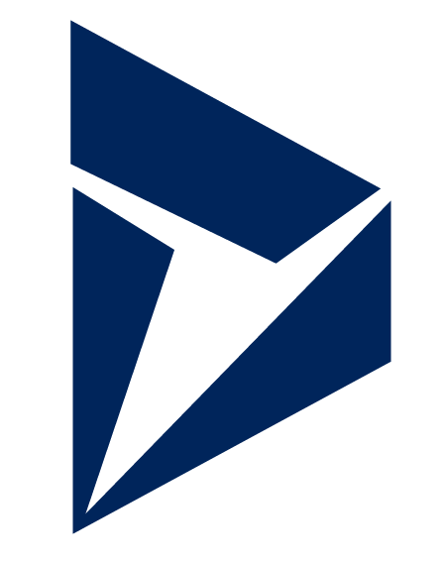




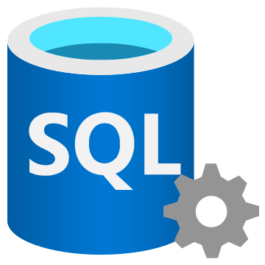
Building modern apps with Azure SQL
IoT
Analytics
Streaming
Visualizations
Automation
Notification
Alerting
Web/Mobile
Service Bus
Relay
Azure Bot Framework
Azure Cognitive Services
Dynamics 365
Azure DevOps
Logic Apps
App Service
Analysis Services
Data Export Service
Azure Data Factory
Azure Pipelines
Power BI Service
PowerApps
Power Automate
Azure Databricks
Azure Machine Learning
Azure Event Hubs
Stream Analytics
Azure Search
Azure Function Apps
Azure Synapse Analytics
Cloud
Azure SQL
On-premises
SQL Server
Scenario discussion
Additional information
Call to action

Slide 93
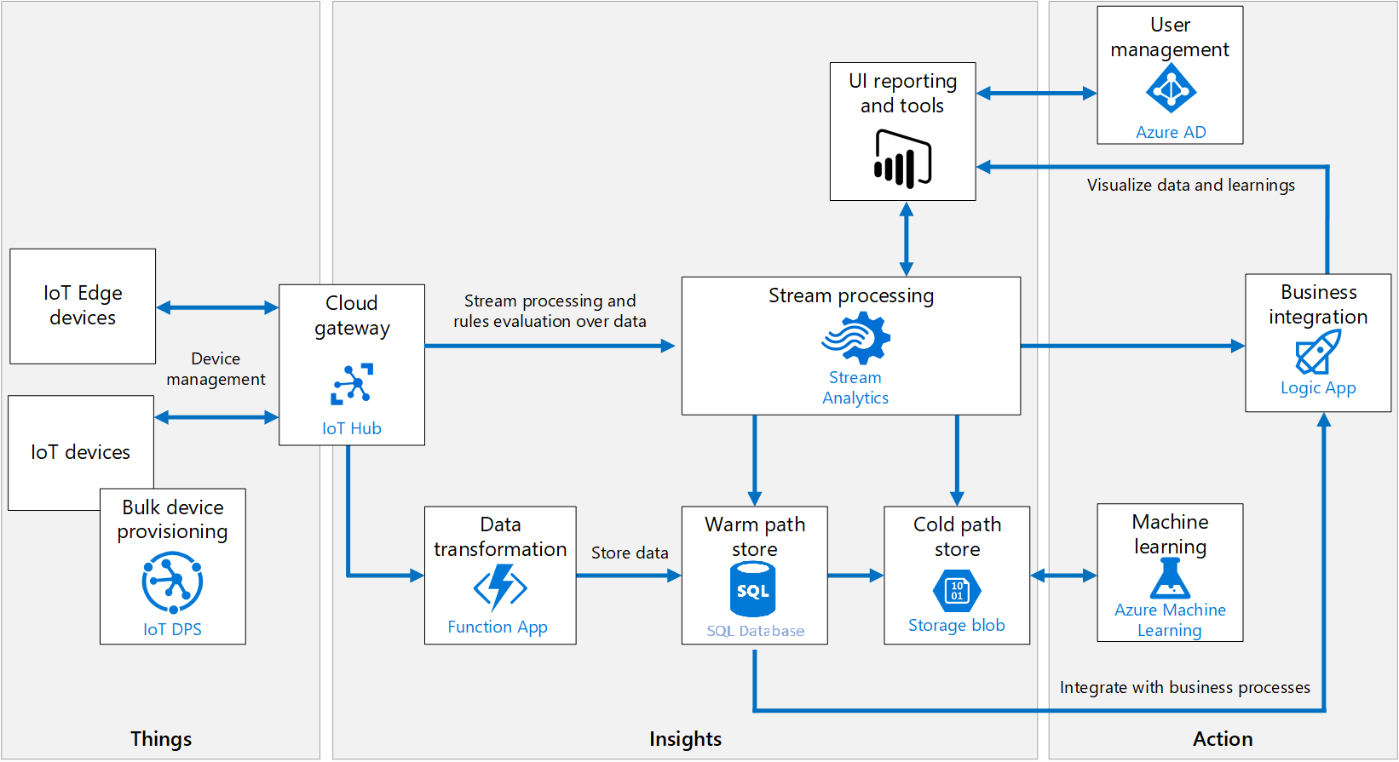
IoT
Scenario discussion
Additional information
Call to action
Notes:
https://docs.microsoft.com/en-us/azure/architecture/reference-architectures/iot-with-sql

Slide 94
Resources
Microsoft Learn: Azure SQL fundamentals learning path
aka.ms/azuresqlfundamentals
Select the Azure SQL Workshop
aka.ms/sqlworkshops
How to choose tool
aka.ms/chooseazuresql
Azure SQL documentation
aka.ms/azuresqldocs
More videos from our team
aka.ms/dataexposed
Scenario discussion
Additional information
Call to action

Slide 95
Try it yourself
Pick a workload
Start small
Decide what to use
Do a proof of concept
Try your SQL Server “toolbox” in Azure SQL
Azure is ready for you
Call to action
Scenario discussion
Additional information
Call to action
Notes:
Go through the labs
Take your projects and decide what to use when
Do a POC, start small
Try your day to day things in SQL Server, and try them in Azure SQL
Circle back on the goals
https://customers.microsoft.com/en-us/story/724156-hr-block-professional-services-azure-sql-server

Slide 96
Thank you!

